Slide 1
Bicycling in Rochester has expanded.

Slide 2
Bicycle Master Plan
The City of Rochester is dedicated to making this a world-class bicycling community. The Rochester Bicycle Master Plan was completed in 2011 and a Complete Streets Policy was adopted shortly thereafter. Since Summer 2011, 16 lane miles of on-street bicycle facilities have been installed with many more planned in the coming year. We have also greatly expanded our off-street trails network and added a significant amount of bicycle parking around the city. Our goal is to be recognized in the upper echelon of American cities for cycling.

Slide 3
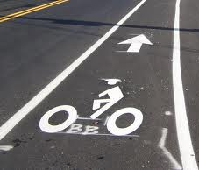
Bike Lanes
This painted symbol on the roadway designates a travel lane for exclusive use by bicycles. Motor vehicles may cross the bike lane to access adjacent parking spaces or to make a turn, but motor vehicles must yield to bicycle traveling in this lane and may not use the bike lane as a travel lane.

Slide 4
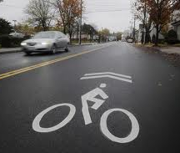
Sharrows
A Shared Lane Use Marking Symbol. Motor vehicles and bicycles should share the travel lane. This painted symbol on the roadway provides guidance for the cyclist as to where to position themselves when riding on the pavement. Bicyclists should ride with their wheels lined up with the center of the marking. Motor vehicles may safely pass bicycles when using caution.

Slide 5
Trails
The statewide Erie Canal Heritage Trail and the Genesee Greenway Trail join with Rochester’s own Genesee Riverway Trail (GRT) in Genesee Valley Park. The GRT extends north through the heart of the City to Lake Ontario and the Port of Rochester before it connects with the east-west Seaway Trail. The GRT hugs both sides of spectacular Genesee Riverway for 16 of the course's 18 miles. It links 11 city parks along the way, each with its own network of trails and paths

Slide 6
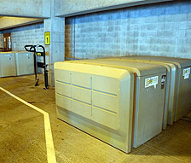
Bike Lockers
The Bureau of Parking Off-Street Division administers the Downtown Bike Locker Program. Individuals can rent a bike locker on a yearly basis at six of the downtown garages run by the City.

Slide 7
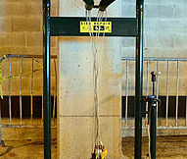
Bicycle Service Stand
These repair stands are free to use and feature an air pump, phillips and flathead screwdrivers, box wrenches (8,9,10,11,15 & 32mm), allen wrenches (2,2.5,3,4,5,6 & 8mm) tire lever, and a torx wrench.
Find service stands at:
Sister Cities Parking Garage: 28 N. Fitzhugh St., Level 1
Genesee Valley Sports Complex: 131 Elmwood Ave.
Maplewood Park: Driving Park Ave. and the Genesee Riverway Trail

Slide 8
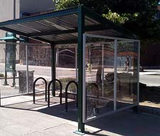
Bicycle Shelter
This three sided sheltered bike rack, located on Court Street at the Genesee Riverway Trail, provides riders with a convenient and dry spot to lock their bikes. It's in a perfect location for people bicycling into downtown via the Genesee Riverway Trail. Sheltered bike racks will soon be installed in all of the City's parking garages, and will be free to use. Currently, sheltered bike racks are located on the street level of the Court Street, Sister Cities and High Falls Garages, and outside of the South Avenue Garage.

Slide 9
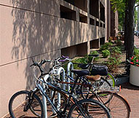
Bike Posts and Bike Racks
Located throughout the city, bike posts and bike racks provide riders with convenient locations to lock their bikes. In 2011 and 2012 the City installed over a hundred new bike posts. In 2012, the City began to offer bike rack rentals for special events to utilize.

Slide 10
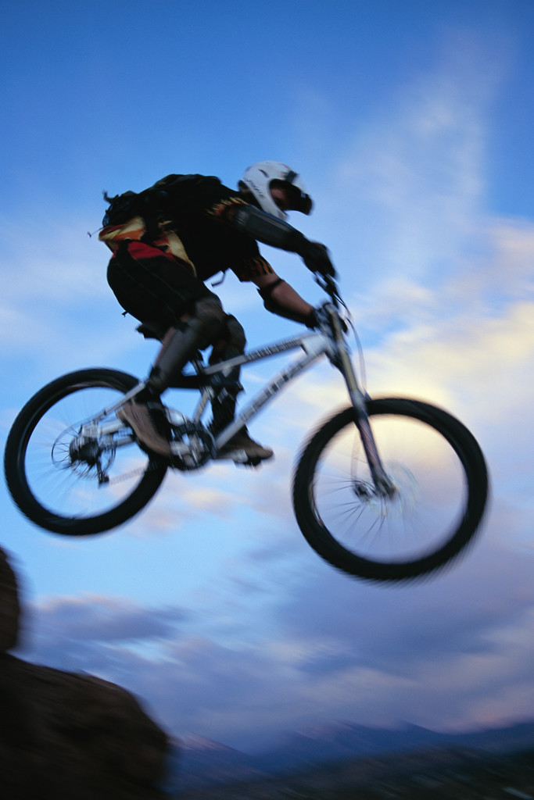
VTL Sections Pertaining to Bicycles

Slide 11
1231. Traffic laws apply to persons riding bicycles or skating or gliding on in-line skates
Every person riding a bicycle or skating or gliding on in-line skates upon a roadway shall be granted all of the rights and shall be subject to all of the duties applicable to the driver of a vehicle by this title, except as to special regulations in this article and except as to those provisions of this title which by their nature can have no application.

Slide 12
Bicycle Specific Laws
1232. Riding on bicycles.
1233. Clinging to vehicles.
1234. Riding on roadways, shoulders, bicycle or in-line skate lanes and bicycle or in-line skate paths.
1235. Carrying articles.
1236. Lamps and other equipment on bicycles.
1237. Method of giving hand and arm signals by bicyclists.
1238. Passengers on bicycles under one year of age prohibited; passengers and operators under fourteen years of age to wear protective headgear.

Slide 13
Some Other Useful Sections
1122-a. Overtaking a bicycle. The operator of a vehicle overtaking, from behind, a bicycle proceeding on the same side of a roadway shall pass to the left of such bicycle at a safe distance until safely clear thereof.
1131. Driving on shoulders and slopes. Except for bicycles and those classes of vehicles required to travel on shoulders or slopes, no motor vehicle shall be driven over, across, along, or within any shoulder or slope of any state controlled-access highway except at a location specifically authorized and posted by the department of transportation. The foregoing limitation shall not prevent motor vehicles from using shoulders or slopes when directed by police officers or flagpersons, nor does it prevent motor vehicles from stopping, standing, or parking on shoulders or slopes where such stopping, standing, or parking is lawful.

Slide 14
Some Other Useful Sections
1146. Drivers to exercise due care. (a) Notwithstanding the provisions of any other law to the contrary, every driver of a vehicle shall exercise due care to avoid colliding with any bicyclist, pedestrian, or domestic animal upon any roadway and shall give warning by sounding the horn when necessary. For the purposes of this section, the term "domestic animal" shall mean domesticated sheep, cattle, and goats which are under the supervision and control of a pedestrian.

Slide 15
Some Other Useful Sections
1214. Opening and closing vehicle doors. No person shall open the door of a motor vehicle on the side available to moving traffic unless and until it is reasonably safe to do so, and can be done without interfering with the movement of other traffic, nor shall any person leave a door open on the side of a vehicle available to moving traffic for a period of time longer than necessary to load or unload passengers.

Slide 16
Thank You for Your Attention!!!

