Slide 1
Monroe Avenue Parking / Mobility Study

Slide 2
Monroe Avenue Parking / Mobility Study
Team Introductions
Fisher Associates
William Price, RLA – Principal in Charge
Frank Armento, AICP CEP – Senior Planner
Sarah Hogan, RLA – Project Manager
Michael Godfrey – Planner
City of Rochester
Josh Artuso - Senior GIS Analyst / City Planner
Doug Benson - Associate City Planner
Marguerite Parrino - Principal Staff Assistant
Project Overview
Josh Artuso - Senior GIS Analyst / City Planner

Slide 3
Monroe Avenue Parking / Mobility Study
Project Status
Inventory Phase January 2016, on-going
Review of existing plans and studies
Inventory Existing Conditions
Inventory Regulatory Signage
Parking Utilization Collection Period
January 11th – January 24th
Public Participation Plan
Develop DRAFT Parking Survey
Project Schedule

Slide 4
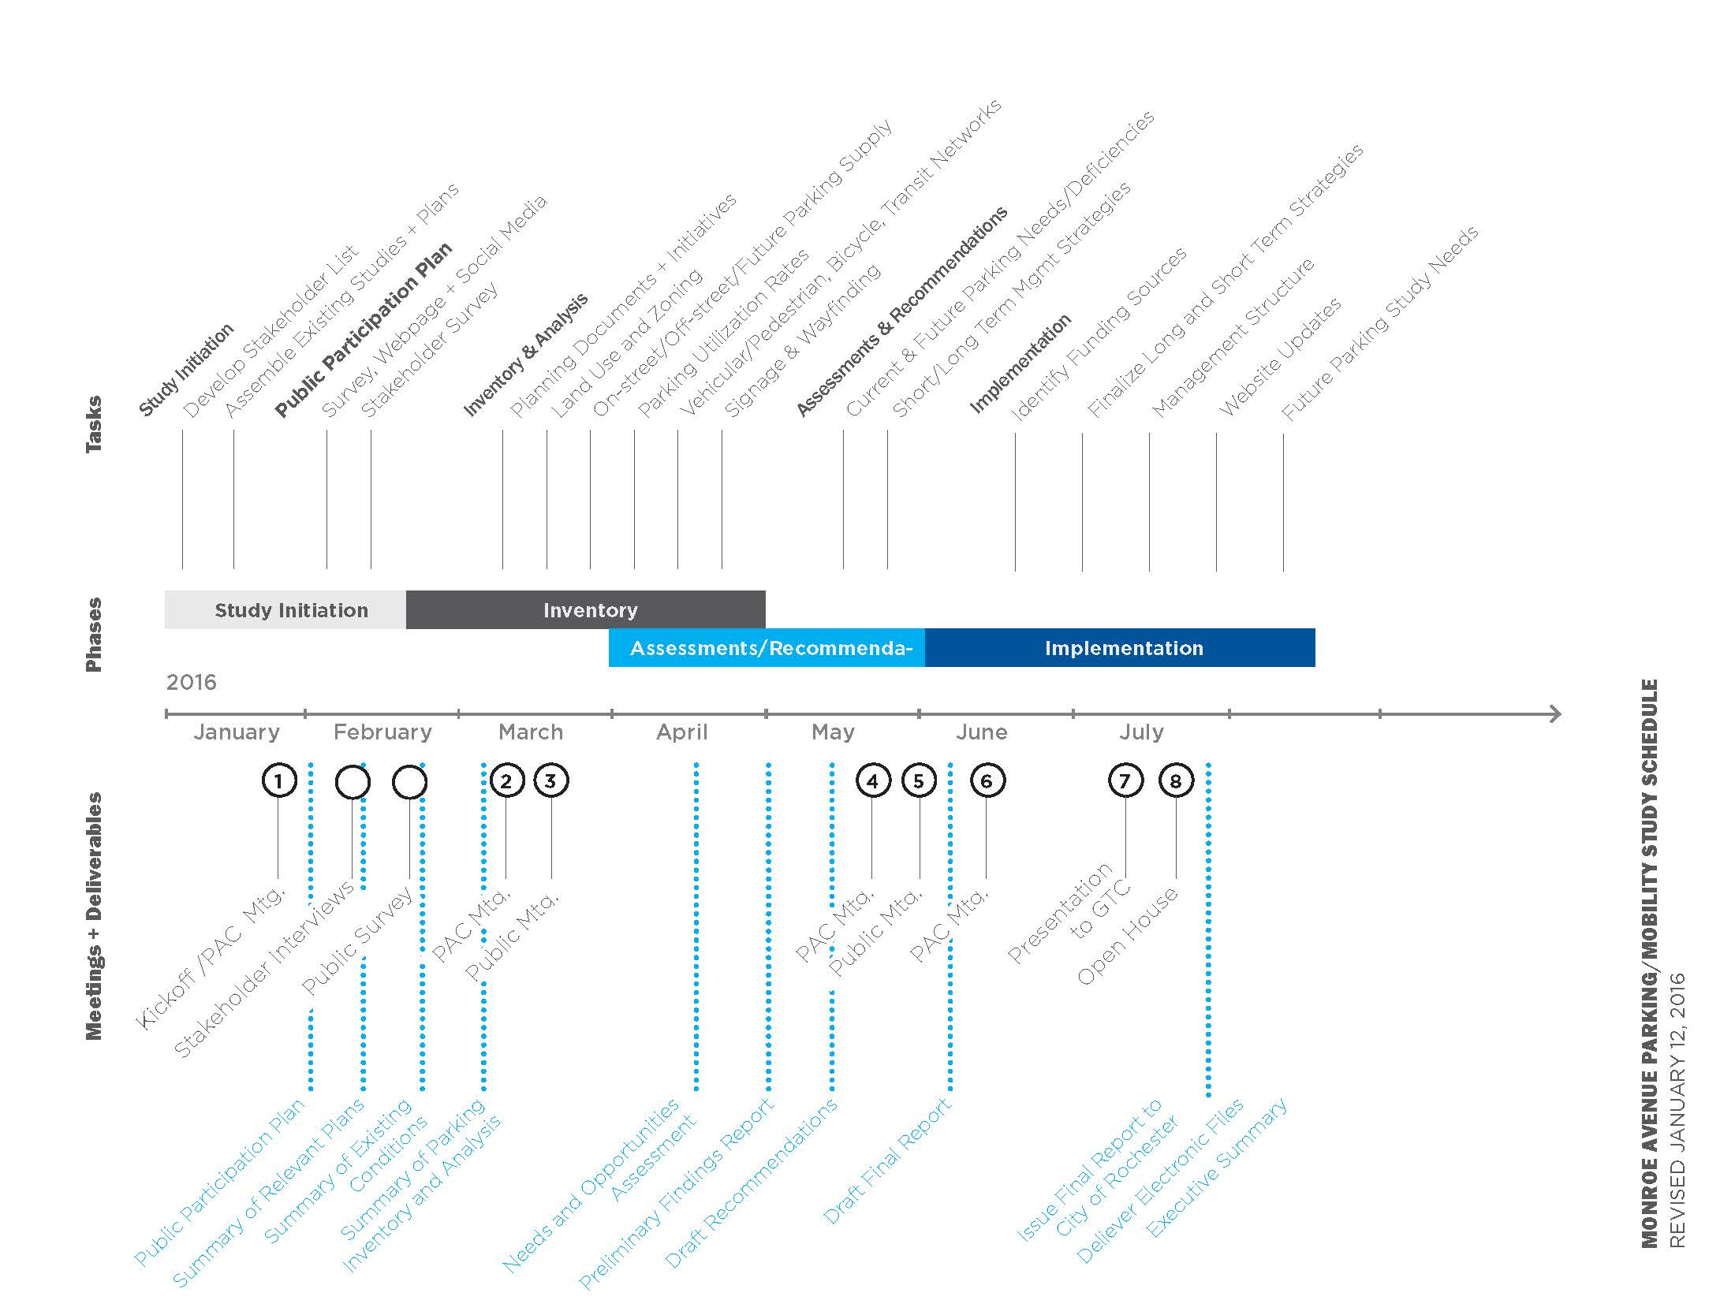
Project Schedule

Slide 5
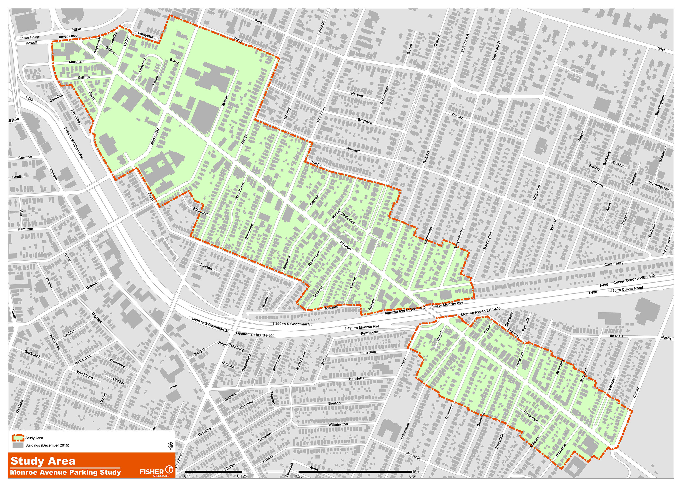
Study Area / Project Boundary

Slide 6
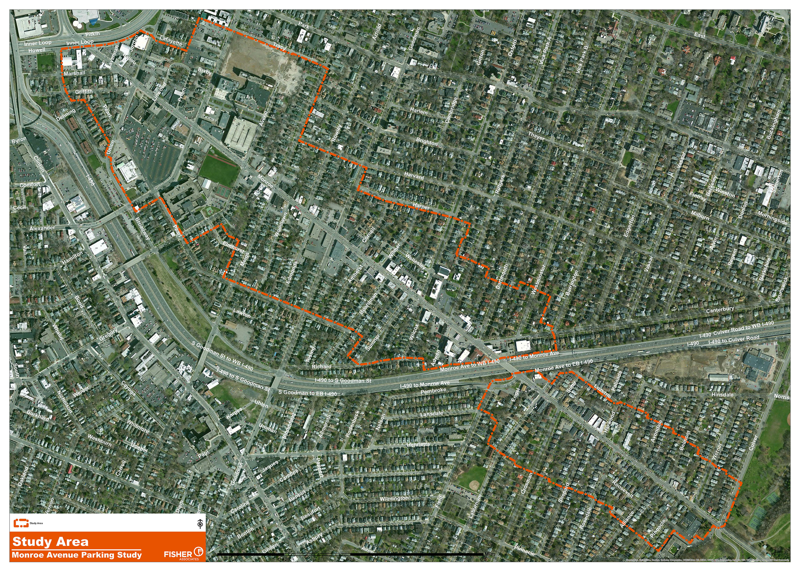
Study Area / Project Boundary

Slide 7
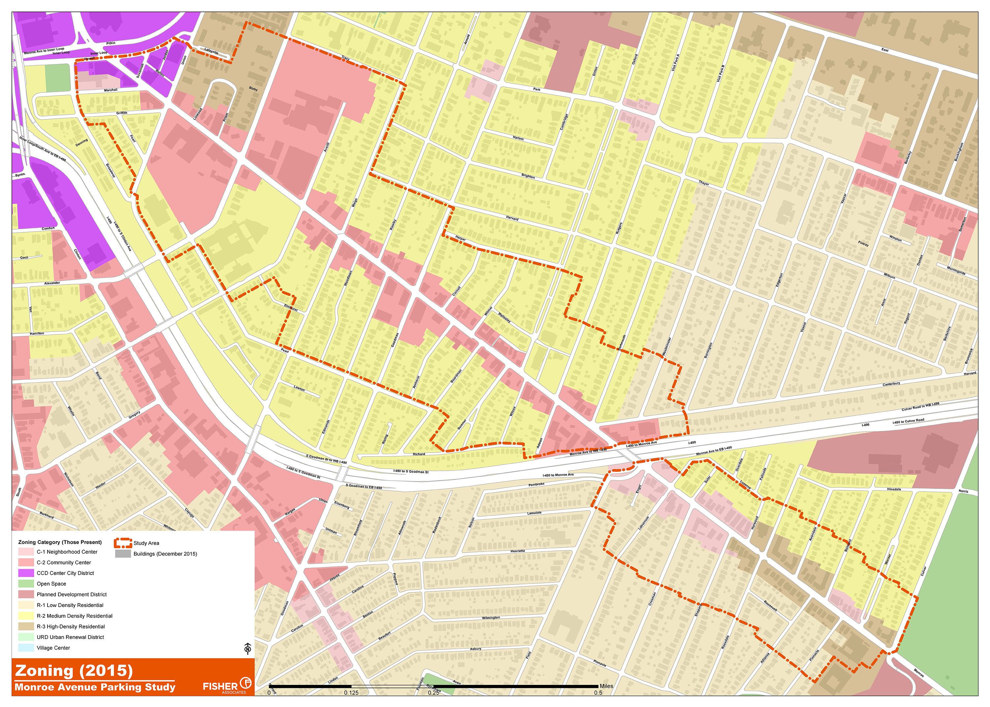
Zoning

Slide 8
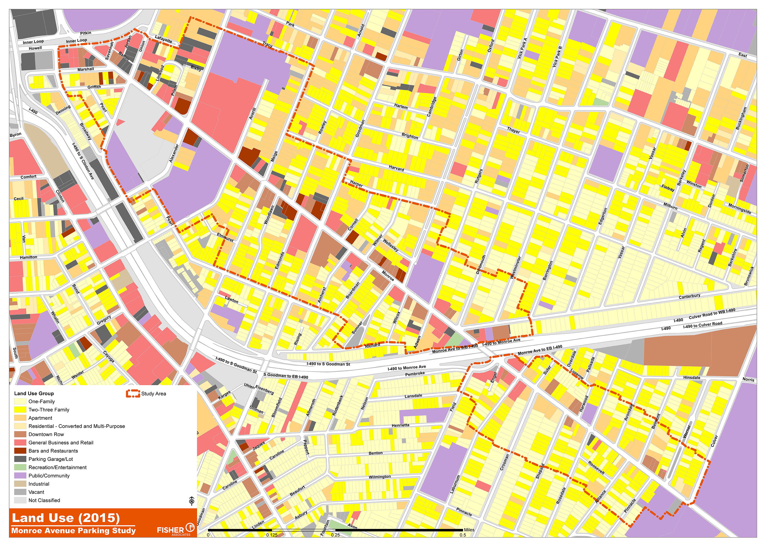
Land Use

Slide 9
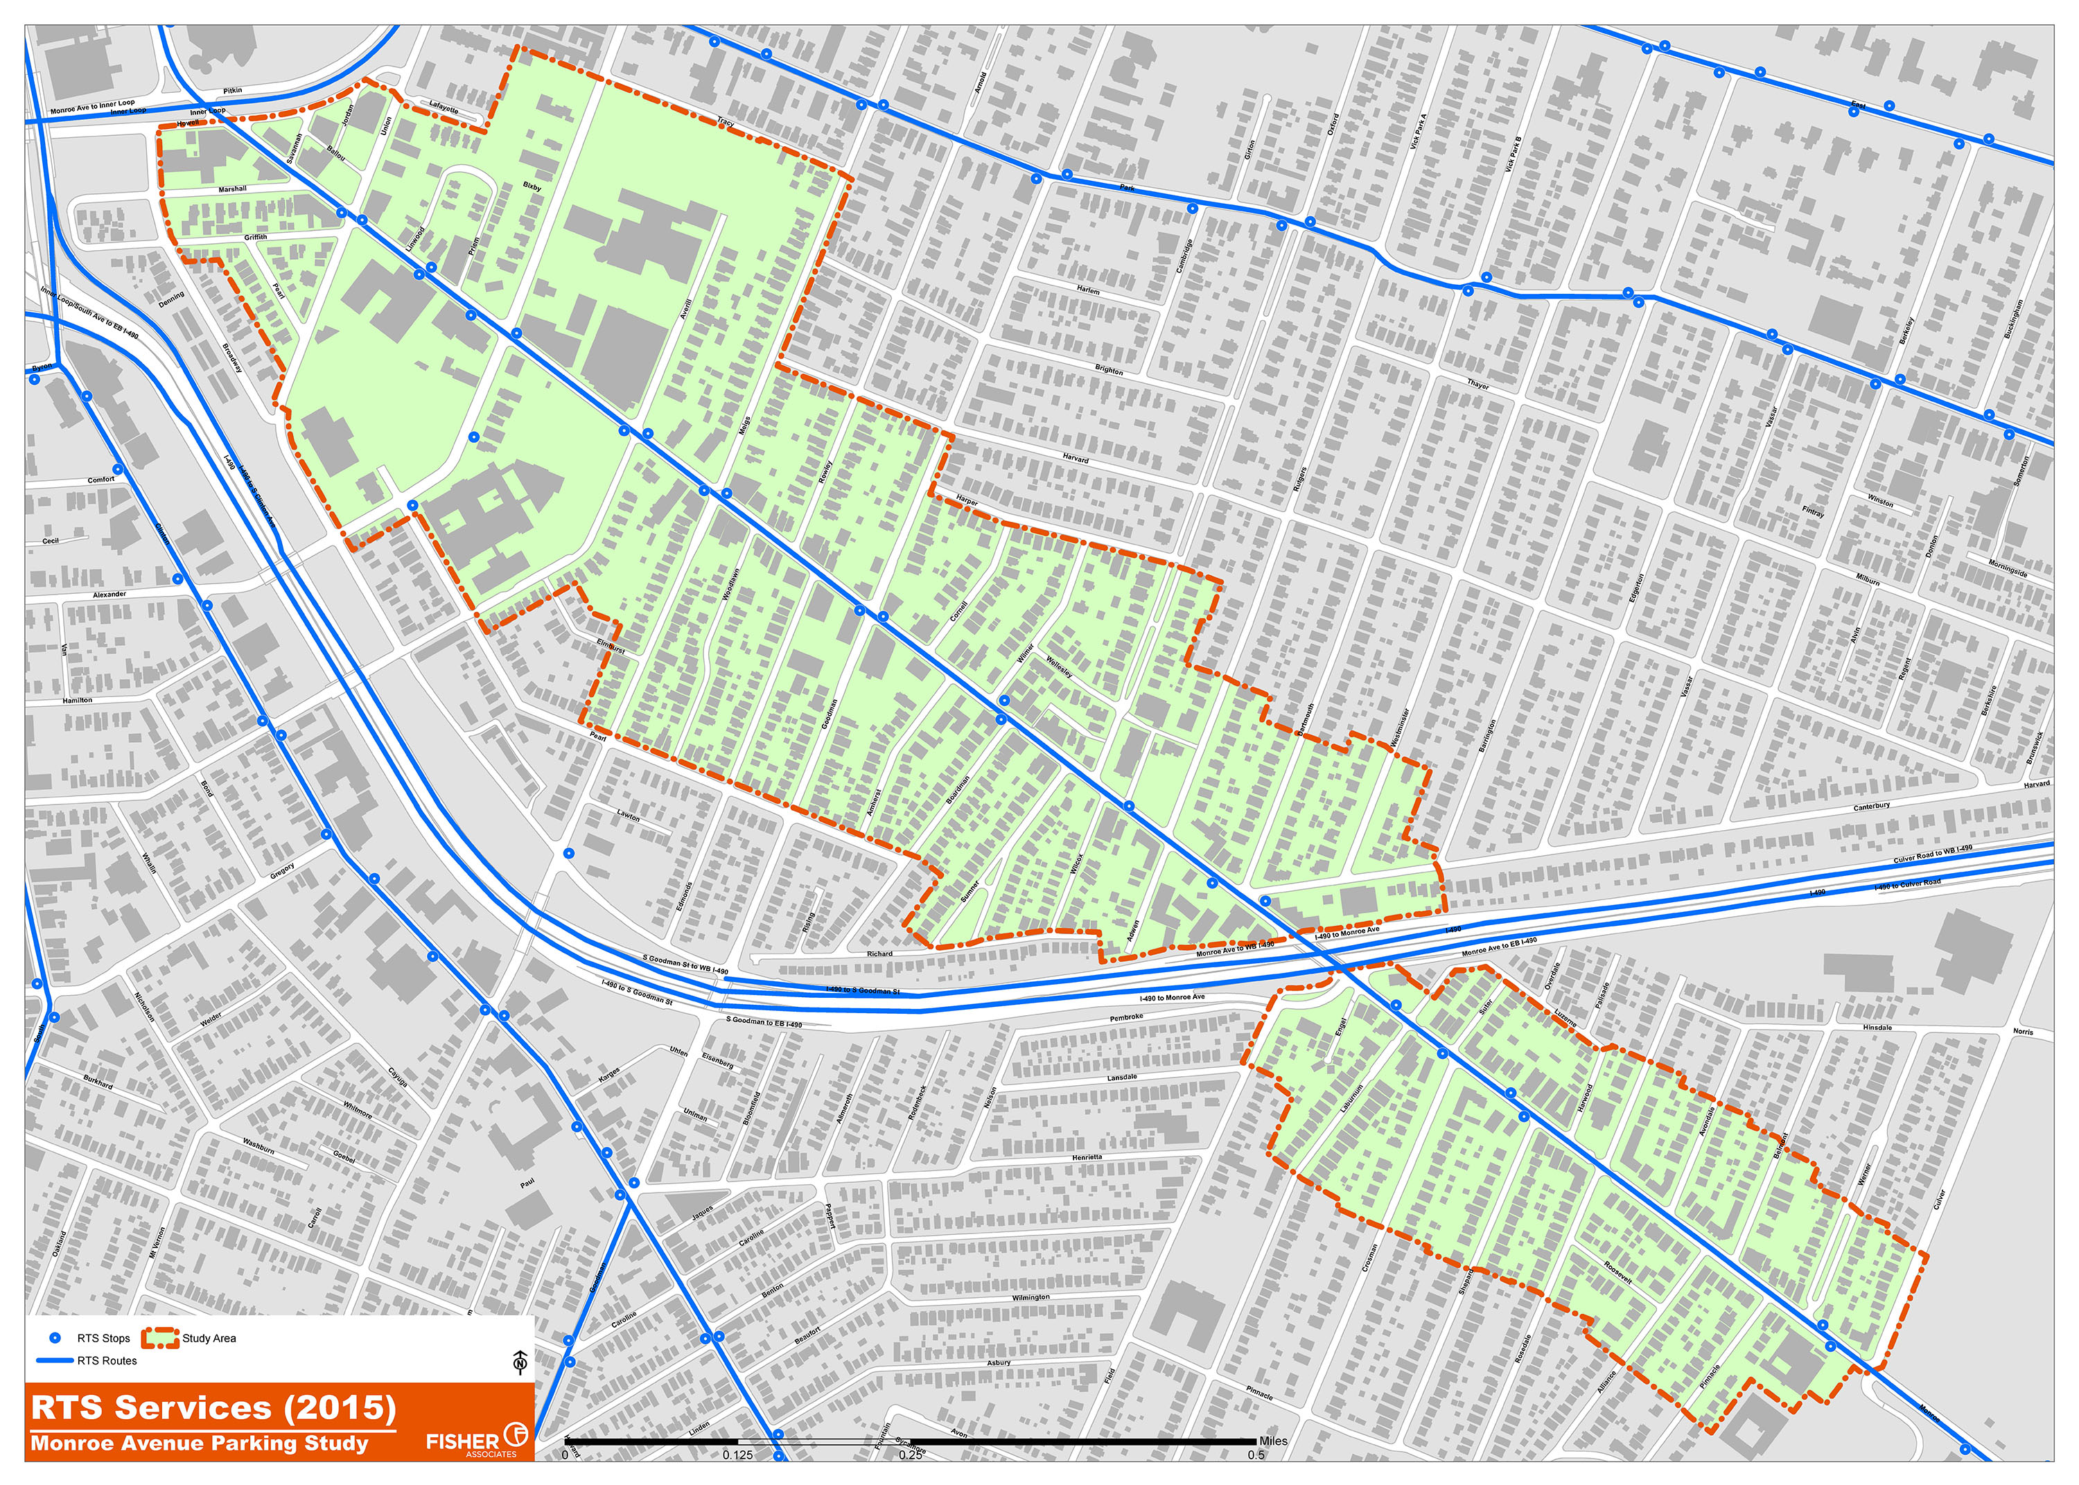
Transit Routes & Stops

Slide 10
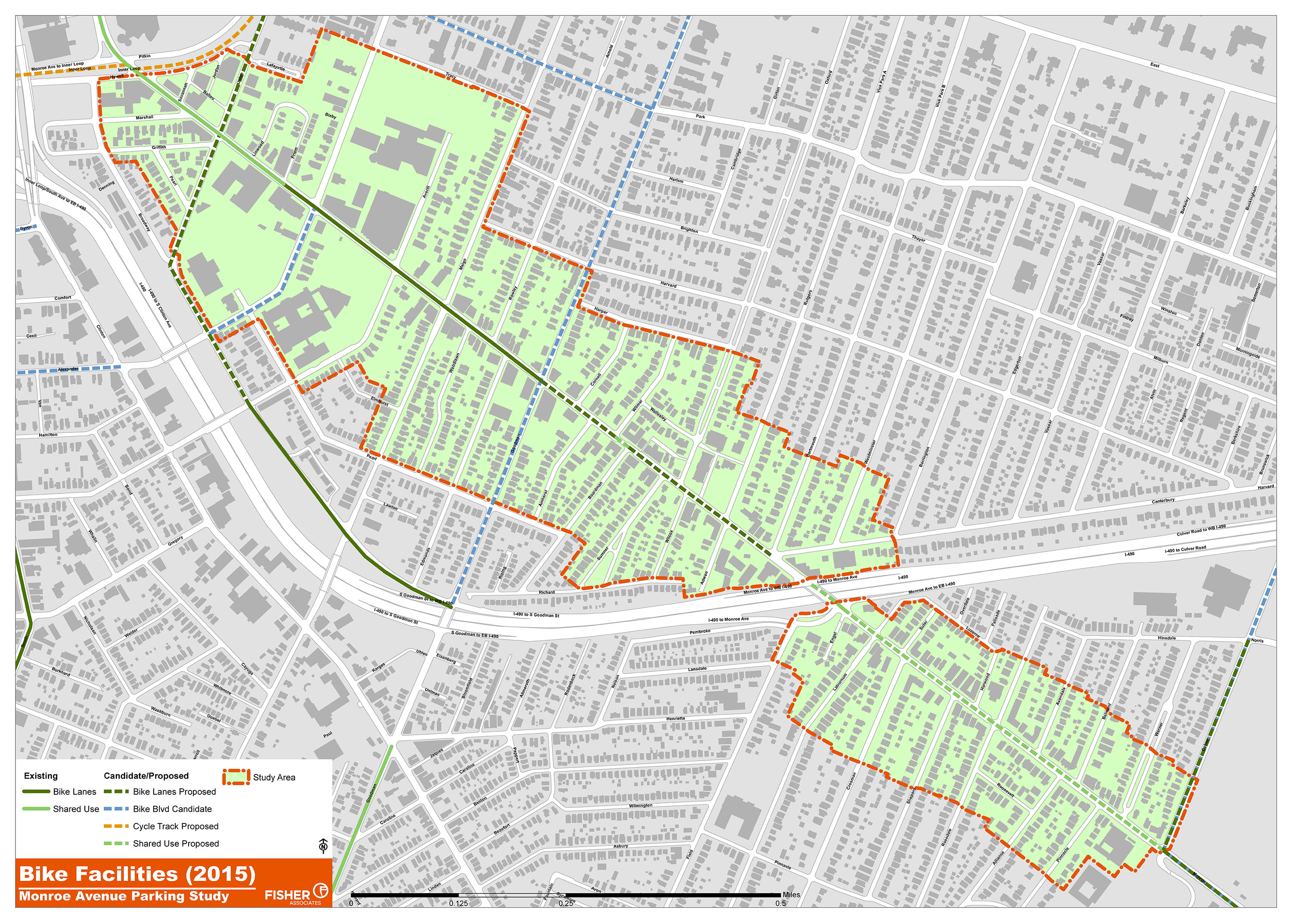
Bike Facilities

Slide 11
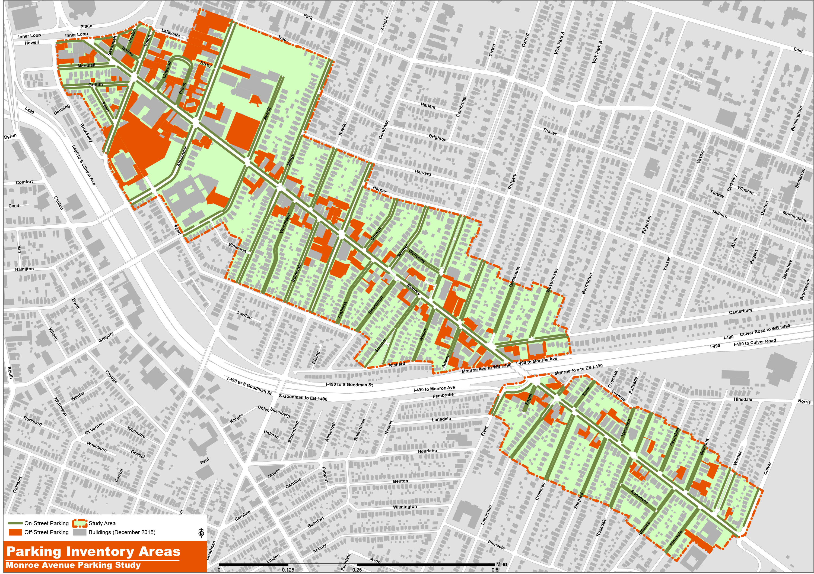
Parking Areas

Slide 12
Methodology Utilization Collection Period
Monroe Avenue Parking / Mobility Study

Slide 13
Parking Survey – Review/Feedback
Monroe Avenue Parking / Mobility Study
Survey Feedback Deadline
1 week, Tuesday – February 16th, 2016
Survey Time Frame Distribution Window
4-6 weeks
Method
Survey Monkey
Advertise & provide link on City website
Send link directly to stakeholder
Obtain contact information/emails from Neighborhood Associations
QR Code / Flyer in business window
QR Code / Flyer at cash register
Link/Flyer with parking ticket

Slide 14
Public Participation Plan
Monroe Avenue Parking / Mobility Study
Public Participation Plan (PPP) is a document that details the specific methodology for community and stakeholder outreach, establishes roles and responsibilities of the Project Team, and identifies key outreach meetings at critical points throughout the process.
Elements of the PPP will include:
Confirmation of Stakeholders
Stakeholder Survey
General Public Survey
Webpage Design/Content
Social Media Strategy
Outline of Public Meetings
DRAFT for review to PAC week of February 22nd, 2016

Slide 15
Stakeholder List
Monroe Avenue Parking / Mobility Study
Develop / Confirmation of Stakeholders
Rochester Police Department
Primary Land Owners
Rochester Regional Transit Service (RTS)
City of Rochester - Department of Environmental Services

Slide 16
PAC Member Discussion
Monroe Avenue Parking / Mobility Study
Corridor Study Goals
Sub-areas to Monroe Avenue Corridor
Next steps

Slide 17
Monroe Avenue Parking / Mobility Study
Next Steps…
Finalize Inventory Phase
Stakeholder Interviews
Draft Public Participation Plan to PAC
Initiate Public Survey
PAC Meeting #2 – Meeting Date TBD
Public Meeting #1 – Meeting Date TBD
Begin Analysis Phase

