Slide 1
Environmental and Geotechnical Cost Penalties Associated with Brownfield Site Development
A Case Study Analysis:
151 Mount Hope Avenue
Rochester, New York
Prepared by:
Jane MH Forbes
City of Rochester – Division of Environmental Quality
November, 2011

Slide 2
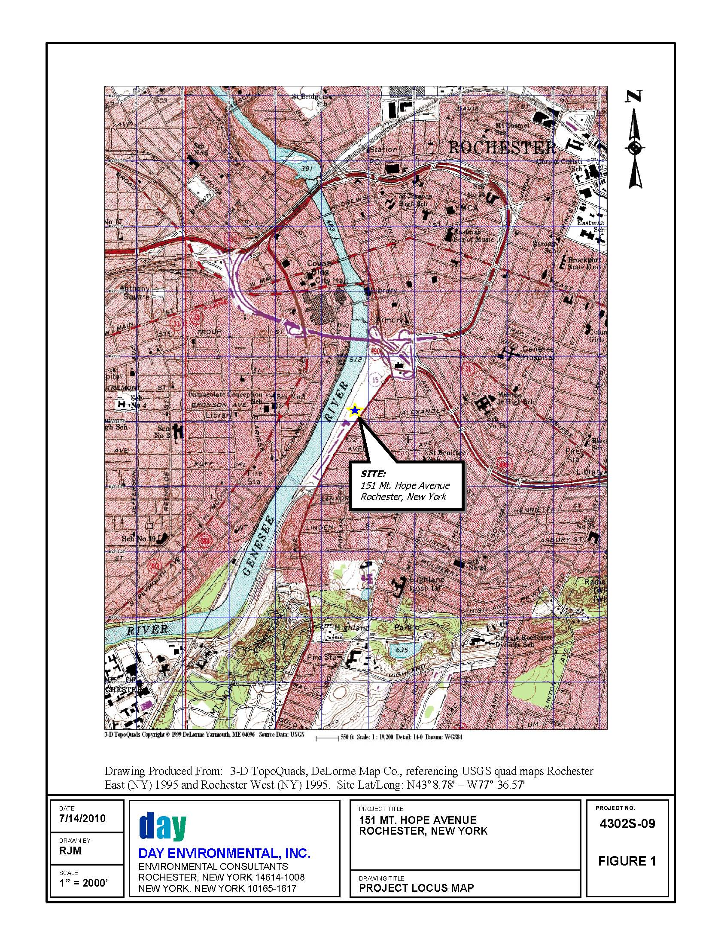

Slide 3
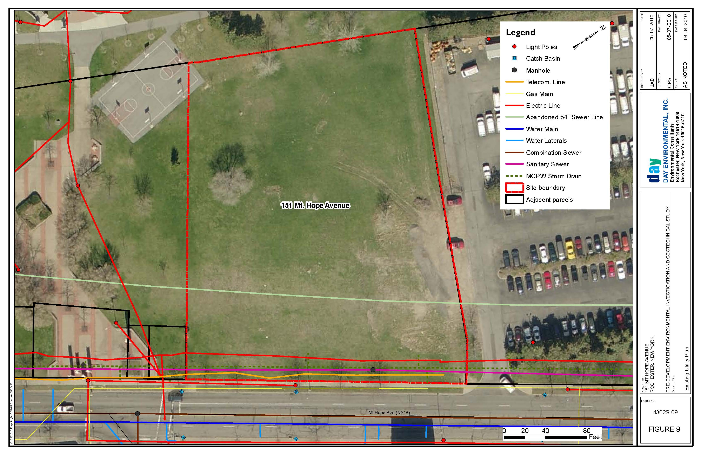

Slide 4
Site Background
The Site is located south of the Inner Loop on the west side of the Genesee River and:
consists of approximately 1.91 acres of undeveloped parkland.
is located in a mixed residential /commercial zoned area.
Is part of the City’s Center City District (CCD)
has been developed for various uses since the mid 1800’s including:
apartment houses
Railroad tracks
Concrete plant
Building materials warehouse with aboveground trestle(s)
Retail stores
Gas station
Erie Feeder Canal
The City is interested in potential development opportunities for the Site, however, environmental and geotechnical issues complicate redevelopment.

Slide 5
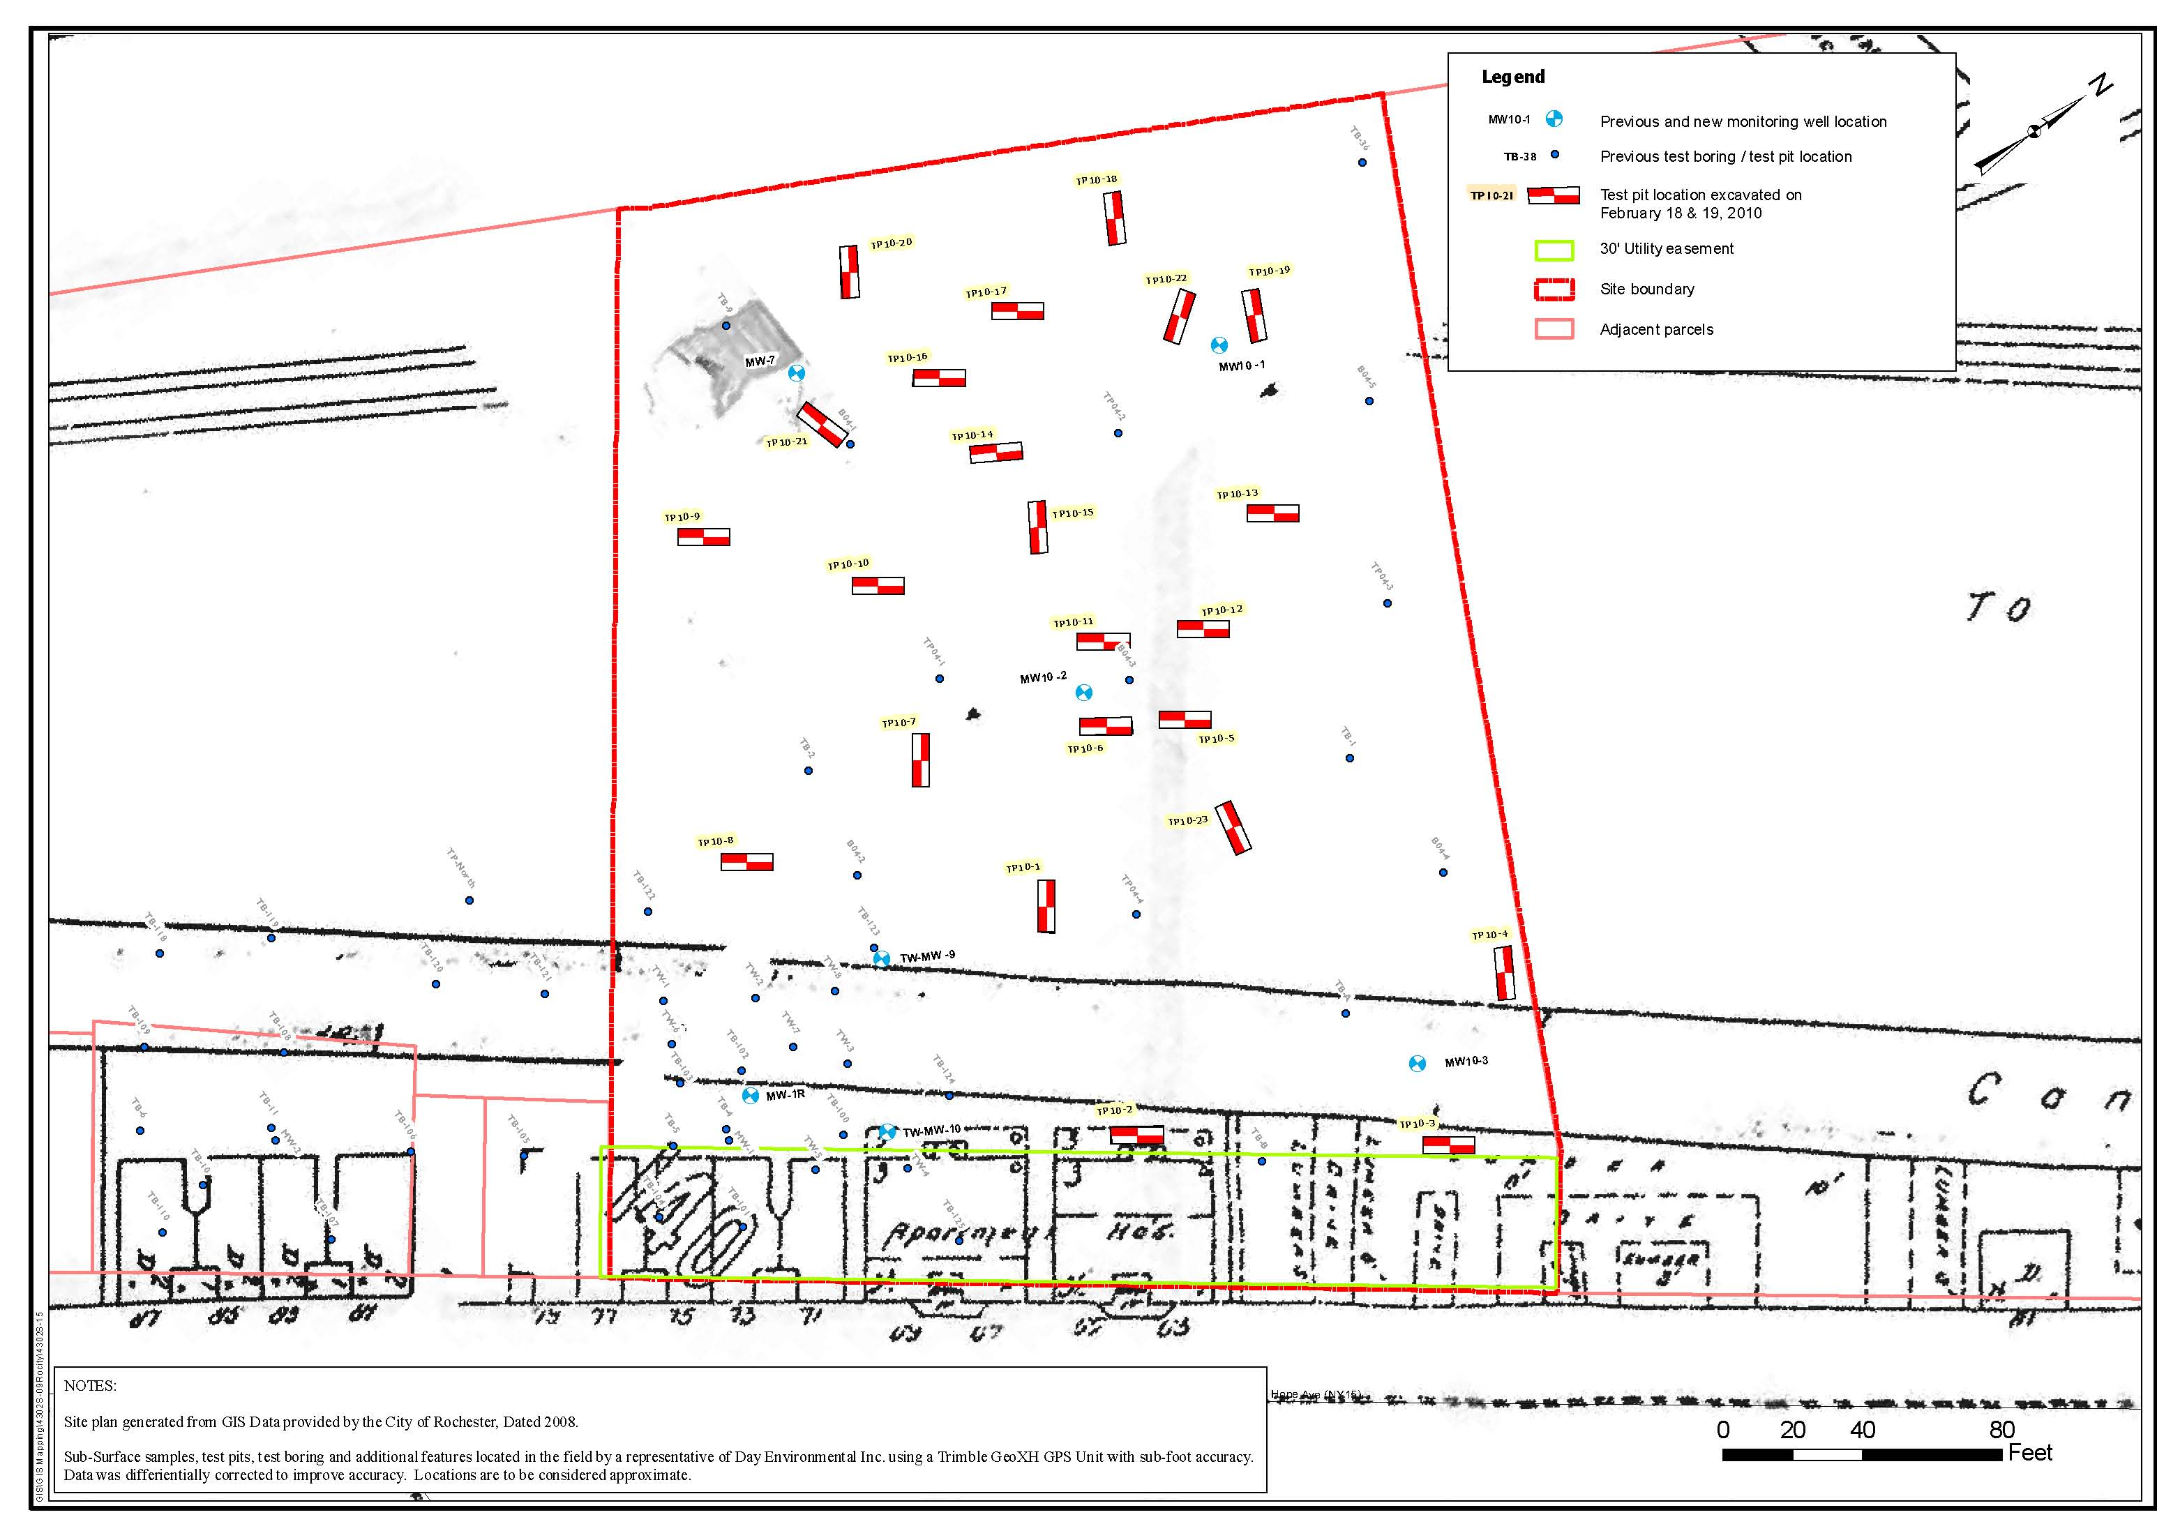
Test Pit, Test Boring and Monitoring Well Locations overlain on 1892 Sanborn Map

Slide 6
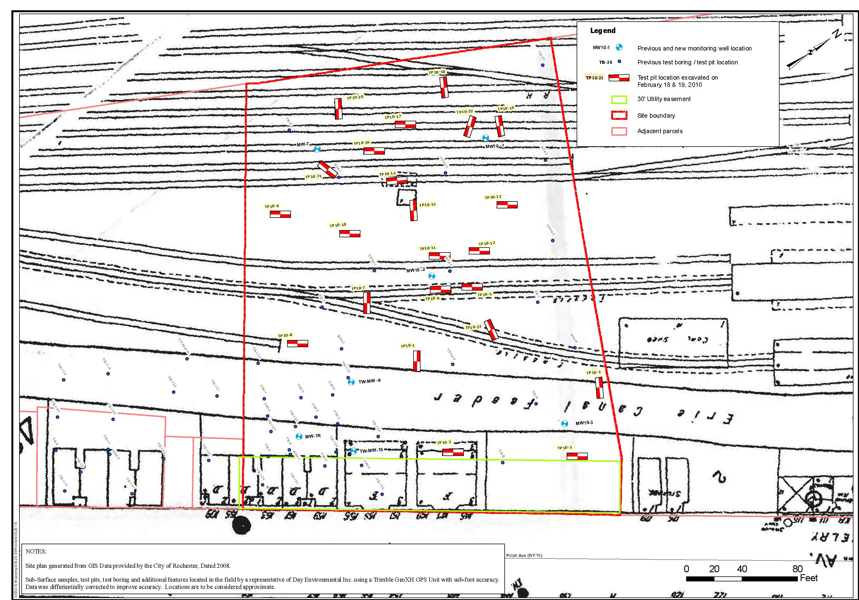
Test Pit, Test Boring and Monitoring Well Locations overlain on 1912 Sanborn Map

Slide 7
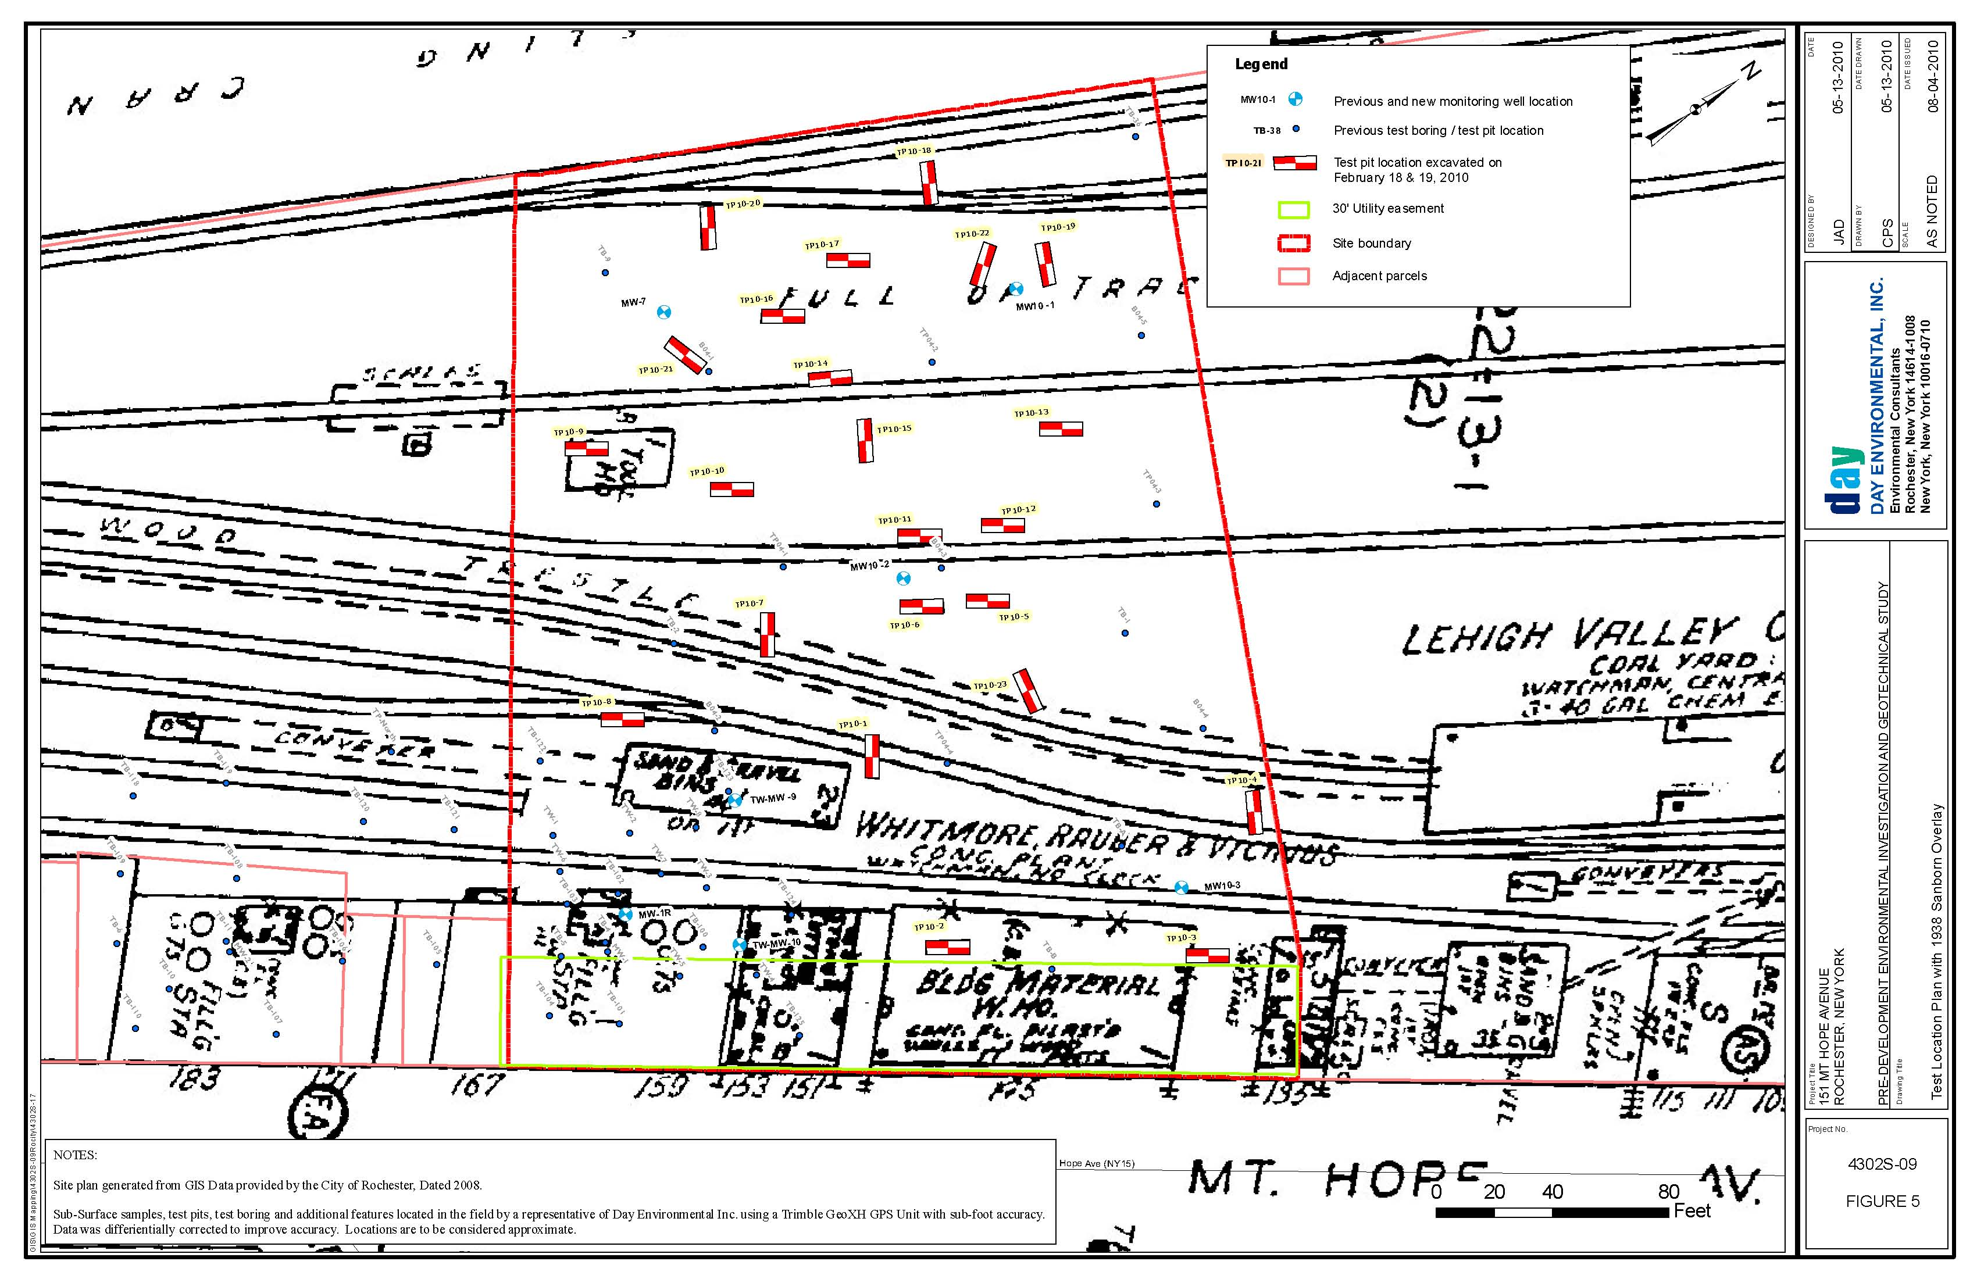
Test Pit, Test Boring and Monitoring Well Locations overlain on 1938 Sanborn Map

Slide 8
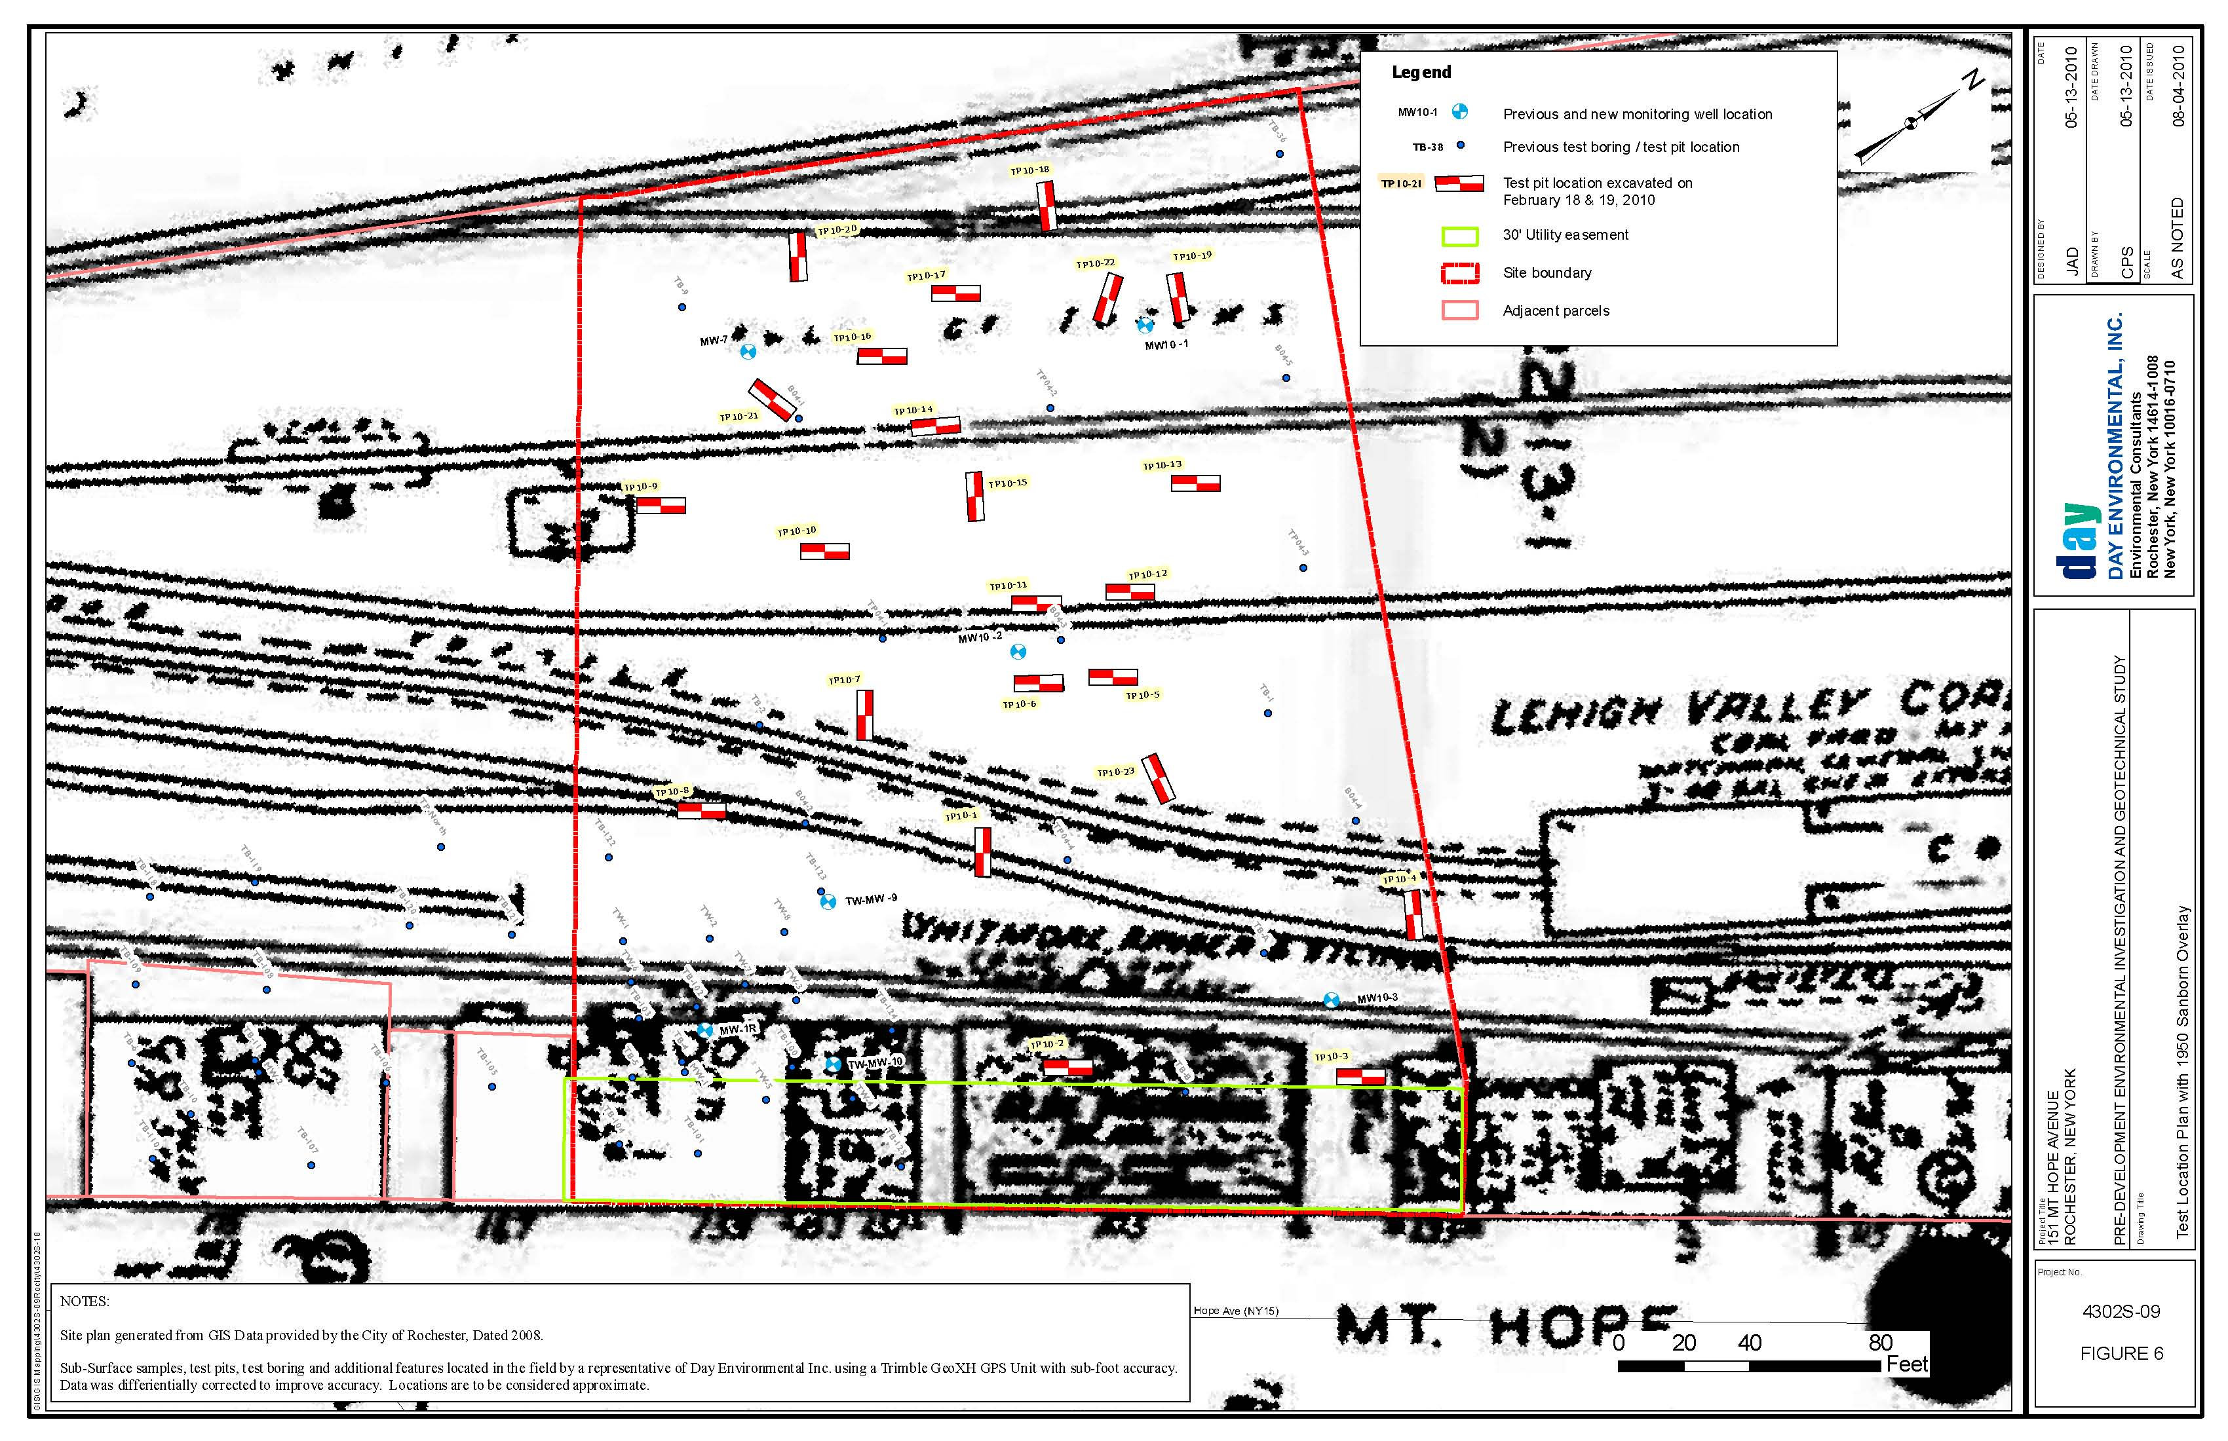
Test Pit, Test Boring and Monitoring Well Locations overlain on 1950 Sanborn Map

Slide 9
Conceptual Re-Development Plan
The Pre-Development Environmental and Geotechnical Evaluation and Opinion of Probable Cost is based on the following assumptions:
Four story, slab on grade construction with partial subsurface parking.
Approximately 31,000 square feet.
Accommodate mixed use first floor commercial retail with upper floor residential.
Open surface parking to the east of the building.
Foundation system consisting of grade beams and structural floor slabs on piles sunk to bedrock.
Installation of a Soil Vapor Intrusion/ Mitigation system under portions of building.

Slide 11
Previous Investigations and Remedial Activities
Previous Environmental Reports include:
Phase I Environmental Site Assessment (2000)
Phase II Environmental Site Assessment (2000)
Phase II Environmental Site Assessment (2002)
Subsurface and Geotechnical Investigation (2004)
Soil Source Removal Remedial Activities (2007)
Pre-Development Environmental investigation and Geotechnical Study (2010)
Previous Environmental Investigation Activities include:
Advancement and sampling of 25 Soil Borings (SBs);
Installation and sampling of seven(7) Monitoring Wells (MWs);
Advancement and sampling of four (4) Geotechnical Soil Borings (GSBs);
Advancement and sampling of 27 Test Pits (TPs)

Slide 12
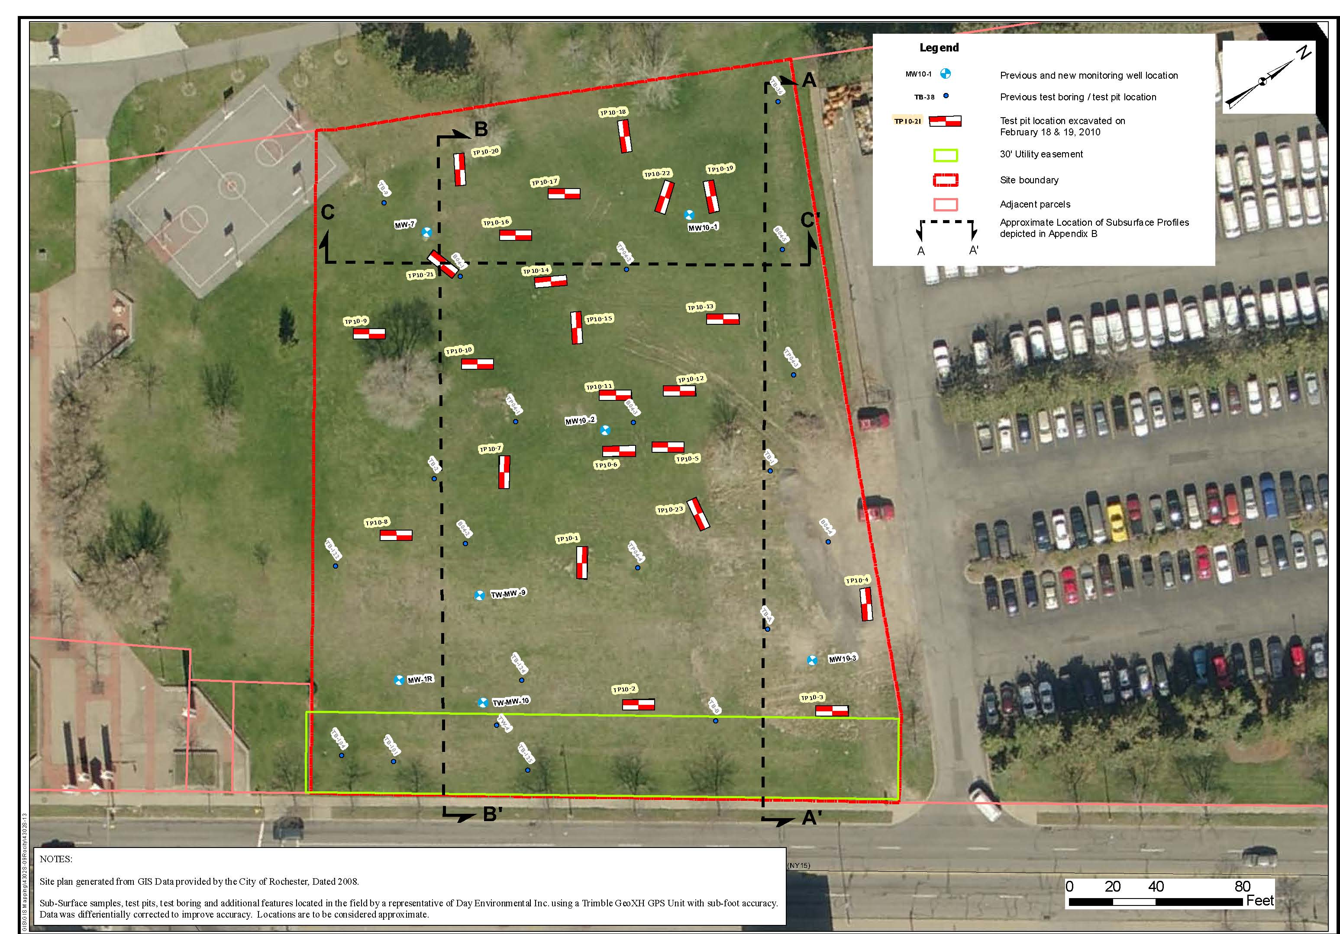
Investigation Test Locations and Cross Section Lines

Slide 13
Site Environmental Conditions
Environmental impacts include VOCs, SVOCs and Metals contamination in soil associated with:
Two (2) USTs at historic use as gas station (circa 1938-50)
Historic use a concrete plant (circa 1938-1950)
Historic use as retail auto sales (circa 1970’s)
Fill (ie. cinders, slag, coal, heavy metals) from historic use as railroad
Unknown materials used as fill for the Erie Canal Feeder
Groundwater analysis results indicated SVOCs and Metals present but below groundwater standards.
Groundwater flow direction is away from the River towards the east.

Slide 14
Site Geotechnical Conditions
The Site is covered by an approximately 0.5 to 1.5 foot thick layer of topsoil;
Fill material consisting of reworked soils (silt to boulder sized), and ash, glass, cinders, slag, brick, lumber, concrete, organics, plastic and metal is present at varying depths across the site ranging from 4 to 15 feet below ground surface (bgs);
Large pockets of mainly incinerator waste comprised of ash, cinders, slag, and non-combustible metal and glass are present within the fill layer;
Groundwater depths range from approximately 11 to 16 feet below ground surface across the Site with a flow direction to the east-southeast;
Dolomite bedrock is encountered between 24.1 and 25.5 feet bgs;
The upper three (3) to five (5) feet of the bedrock layer is highly fractured.
In-place fill and underlying organic silt/clay deposits are unsuitable to support new construction.

Slide 15
Site Geotechnical Conditions
Based on the Conceptual Redevelopment Plan, approximately 8,576 cubic yards(CY) of fill/ soil will be displaced during redevelopment, including:
1,500 CY topsoil stripping;
1,837 CY excavation of grade beams/pile caps;
2,600 CY underground utility excavations;
890 CY Parking Lot/ Sidewalk Box-Out;
600 CY Pre-Excavation for Pile obstructions;
743 CY 10% Contingency Soil Excavation Volume;
406 CY Hoe-Ramming and removal of Concrete Obstructions.

Slide 16
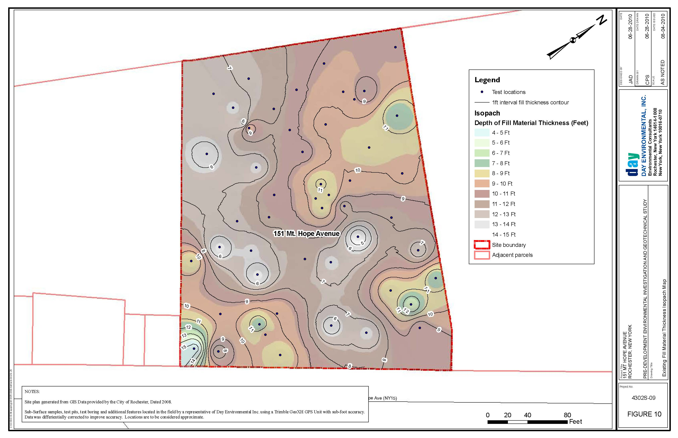
Existing Fill Material Thickness Isopatch Map

Slide 18
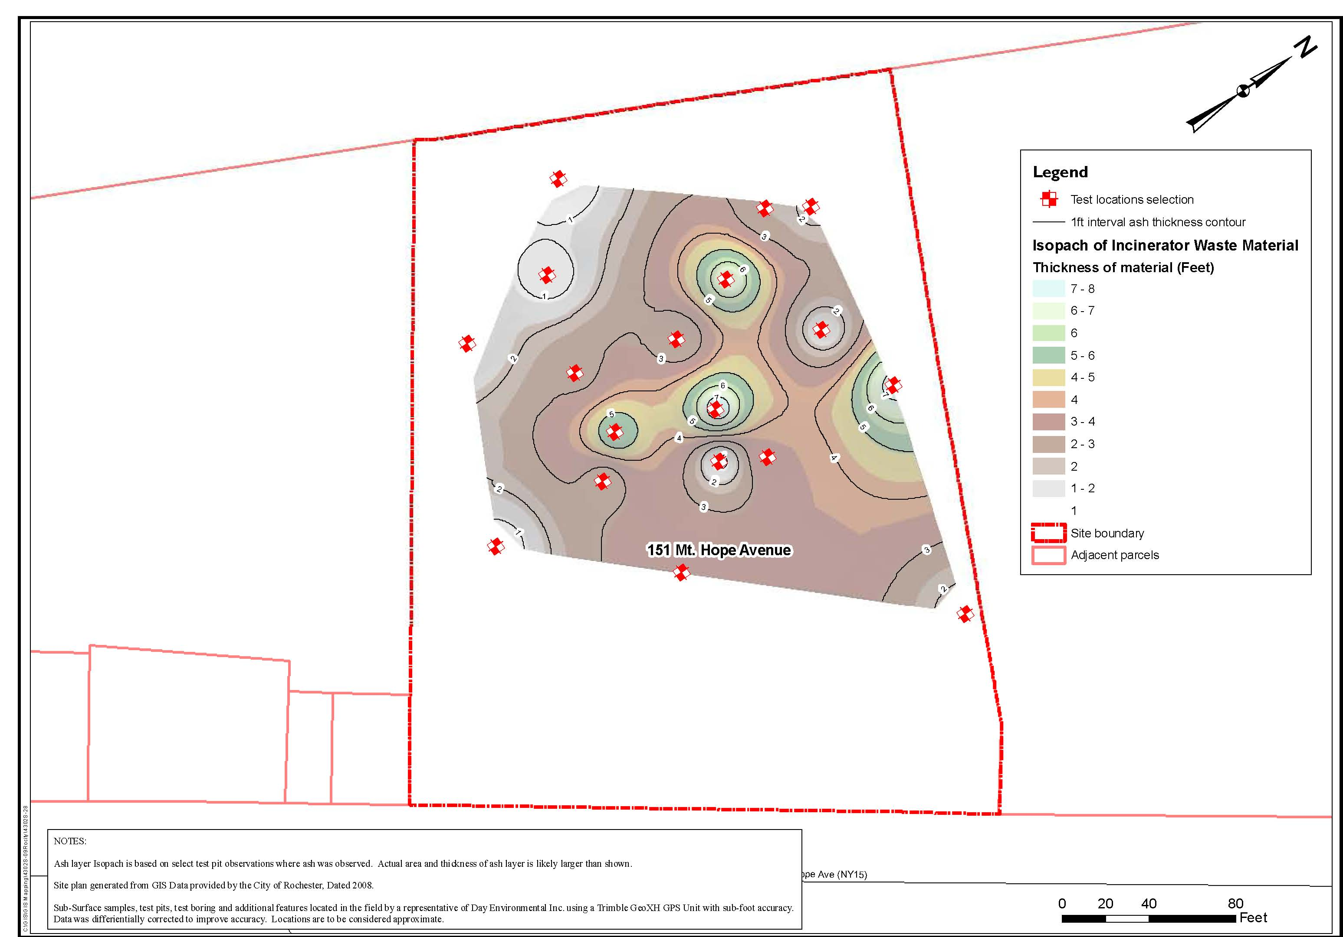
Existing Incinerator Waste Layer Thickness Isopatch Map

Slide 20
Anticipated Cost Penalties for Property Development
Geotechnical Costs:
Geotechnical & Structural Engineering Oversight
Excavation & Construction of Foundation System
Fill and Storm Water Management
Underground Utility, Parking, and Sidewalks preparation
Contingency Items (corrosion protection, excess fill volume, subsurface obstructions, etc.)
Environmental Costs:
Plan Development (EMP, HASP, CAMP)
Environmental Consultant Oversight (Well Decommissioning, Project Monitor)
On-Site Soil and Fill Management, Analysis, Transport, and Off-Site Disposal
Soil Vapor Intrusion System Design and Installation
Construction Closure Reporting

Slide 21
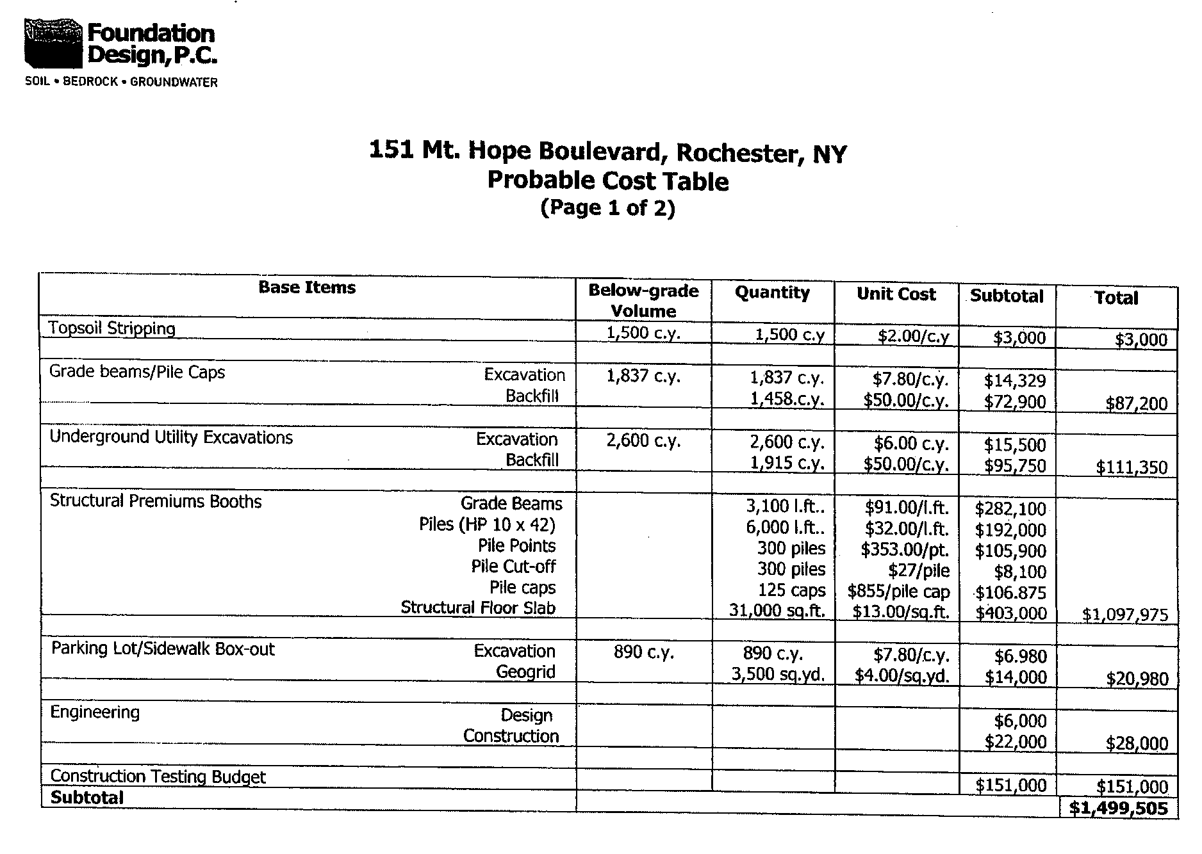

Slide 23
Opinion of Probable Costs (DAY Engineers 2010)
Task Description | Cost
Plan Development | $2,500
Environmental Consultant Oversight | $20,500
Soil and Fill Material Management (On & Off-Site)
Soil Analysis | $21,500
Soil Transport (Off-Site) | $146,000
Soil Disposal * | $445,500
Soil Vapor Intrusion/ Mitigation System Costs | $72,500
Construction Closure Reports | $6,500
Estimated Total Environmental Consulting Costs | $715,000
Estimated Total Geotechnical Consulting Costs | $1,795,713
Total Estimated Environmental & Geotechnical Costs | $2,510,713
* Maximum 14,150 tons of soil disposed of at permitted landfill facility

Slide 24
NOTES:
Significant cost savings can be realized if excavated soils can be re-used on Site. However, soil suitability is an issue (ie. incinerator ash).
Project is assumed to be completed outside of formal NYSDEC Brownfields programs.
Cost estimates based on a generic redevelopment plan, actual costs will vary with Site-specific design.

