Slide 1
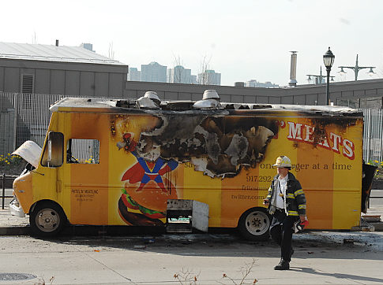
Fire safety and utility control for mobile food service vehicles
Rochester Fire Department – Fire Marshal’s Office

Slide 2
Fire safety and utility control
WHY IS RFD TEACHING THIS CLASS TODAY?

Slide 3
Fire safety and utility control
Explain our collective role in safety
Learn Fire Chemistry
Fire Suppression Safety
Extinguish a small fire using a fire extinguisher

Slide 4
Fire safety and utility control
Learn some basic gas safety tips (Gasoline, Propane, CNG)
Fire and utility hazards specific to Mobile Food Vehicles
Hazardous Materials safety and placards

Slide 5
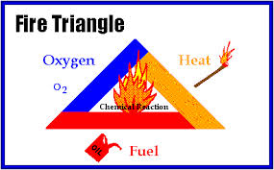
Fire safety and utility control
THE FIRE TRIANGLE
HEAT
FUEL
OXYGEN

Slide 6
Fire safety and utility control
5 CLASSES OF FIRE
Ordinary Combustibles
Flammable and Combustible Liquids
Energized Electrical Equipment
Combustible Metals
K. Cooking Oils

Slide 7
Fire safety and utility control
KITCHEN FIRE SAFETY

Slide 8
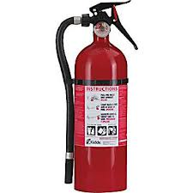
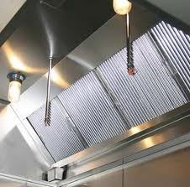
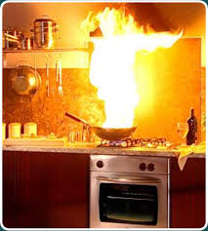
Fire safety and utility control
TYPES OF FIREFIGHTING RESOURCES
Extinguishers
Hood Systems
Confinement
Smother

Slide 9
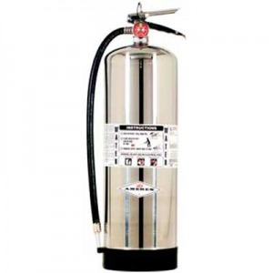
Fire safety and utility control
TYPES OF FIRE EXTINGUISHERS
Water
Dry Chemical
Carbon Dioxide
Specialized Fire Extinguishers

Slide 10
Fire safety and utility control
DO NOT USE WATER ON A GREASE FIRE

Slide 11
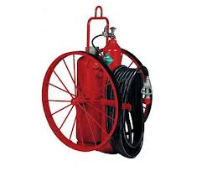
Fire safety and utility control
TYPES OF FIRE EXTINGUISHERS
Water
Dry Chemical
Carbon Dioxide
Specialized Fire Extinguishers

Slide 12
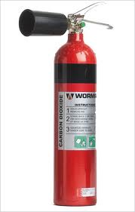
Fire safety and utility control
TYPES OF FIRE EXTINGUISHERS
Water
Dry Chemical
Carbon Dioxide
Specialized Fire Extinguishers

Slide 13
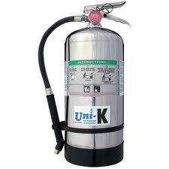
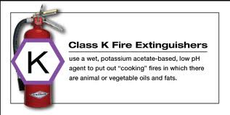
Fire safety and utility control
TYPES OF FIRE EXTINGUISHERS
Water
Dry Chemical
Carbon Dioxide
Specialized Fire Extinguishers

Slide 14
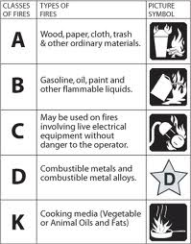
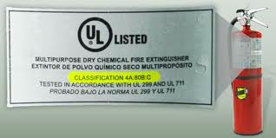
Fire safety and utility control
FIRE EXTINGUISHER LABELS & RATINGS
The Label shows what type of fires the fire extinguisher can be used for.
The higher the number on the label, the more product is in the extinguisher.

Slide 15
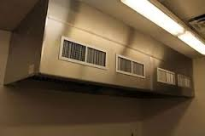
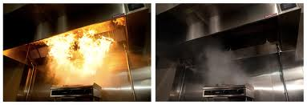
Fire safety and utility control
TYPE 1 HOOD SYSTEMS AND FIRE SUPPRESSION SYSTEMS
2014
VEHICLES’ MUST HAVE A TYPE 1 HOOD IN PLACE
2015
VEHICLES’ MUST HAVE A FIRE SUPPRESSION SYSTEM IN PLACE

Slide 16
Fire safety and utility control
***The Rochester Fire Department does NOT endorse any specific brand or vendor. We simply enforce that systems are installed correctly and meet code.***
This video was chosen because its 10 minutes shorter than the other one we had!

Slide 17
Fire safety and utility control

Slide 18
Fire safety and utility control
WHAT TO DO WHEN FIRE HAPPENS TO YOU:
R.A.C.E
RESCUE, ALERT, CONFINE, EXTINGUISH
P.A.S.S.
PULL, AIM, SQUEEZE THE TOP, SWEEP SIDE TO SIDE

Slide 19
Fire safety and utility control
WHAT NOT TO DO WHEN FIRE HAPPENS TO YOU:
DON’T GET TO CLOSE TO THE FIRE
DON’T FORGET YOUR FUEL SHUT OFF’S
NEVER TRY TO FIGHT A FIRE ALONE
REMEMBER THAT SMOKE OFTEN KILLS BEFORE FIRE!
DON’T BLAST AGENT INTO LIQUID FIRES (P.A.S.S.)

Slide 20
Fire safety and utility control

Slide 21
Fire safety and utility control
GAS SAFETY:
PROPANE
NATURAL GAS
CARBON MONOXIDE
GASOLINE
DIESEL
CARBON DIOXIDE
CHECK FOR LEAKS USING SOAP AND WATER

Slide 22
Fire safety and utility control
GAS SAFETY:
PROPANE
Referred to as Liquefied Petroleum – Hence LP Gas.
Ignition temperature is 920-1120˚ degrees.
Specific Gravity (at 60 ˚) is 1.50. Heavier than air.
Maximum temperature is 3,595 ˚.
Expansion rate is 270:1.

Slide 23
Fire safety and utility control

Slide 24
Fire safety and utility control

Slide 25
Fire safety and utility control
GAS SAFETY:
NATURAL GAS
Is not toxic! It is an asphyxiant. Displaces oxygen from environment.
It is colorless and odorless. Mercaptan is added. Rotten eggs.
It is lighter than air and dissipates rapidly.
It can easily ignite (at 1100 degrees) and can be explosive.
If the mixture is right, even static from clothing could ignite.

Slide 26
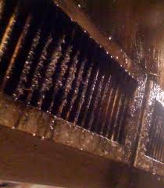
Fire safety and utility control
GAS SAFETY:
CARBON MONOXIDE (CO)
Created by the incomplete combustion of any fuel.
CO is colorless, odorless, tasteless and no smells can be added.
CO can make kill you slowly over time or within minutes.
Typically occurs when ventilation systems fail to work or cooking (heating) appliances burn incompletely.
Symptoms include: headache, nausea, short of breath, dizzy, confused, or faint.
CO attaches to your red blood cells and keeps oxygen out.

Slide 27
Fire safety and utility control
GAS SAFETY:
GASOLINE – ITS ALL ABOUT THE VAPOR
Gas vapor travels long distances from its source.
Gas gives off vapor even at 45 degrees below zero.
Gas vapor is heavier than air
The potential energy of one gallon of gas equals numerous sticks of dynamite.
Use good hygiene after handling gas. Gasoline contains Benzene, a carcinogen.

Slide 28
Fire safety and utility control
ITS ALL ABOUT THE VAPORS!

Slide 29
Fire safety and utility control
ITS ALL ABOUT THE VAPORS!

Slide 30
Fire safety and utility control
STATIC CHARGE CAN IGNITE VAPORS!

Slide 31
Fire safety and utility control
GAS SAFETY:
DIESEL
Flashpoint is 100-125 degrees F.
It is a Combustible gas
Unless filtered (scrubbed) it tends to be a dirty fuel.
Creates a good deal of Carbon Monoxide
Only true protection is a CO detector.

Slide 32
Fire safety and utility control
GAS SAFETY:
CARBON DIOXIDE (CO2)
Not generally considered a hazard. 10,000ppm for 8 hours.
People exhale CO2.
CO2 is an asphyxiant as it displaces oxygen in an area.
Is created by burning fuels as well.
Runs the Soda Fountain systems. A leak can be dangerous.

Slide 33
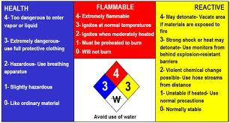
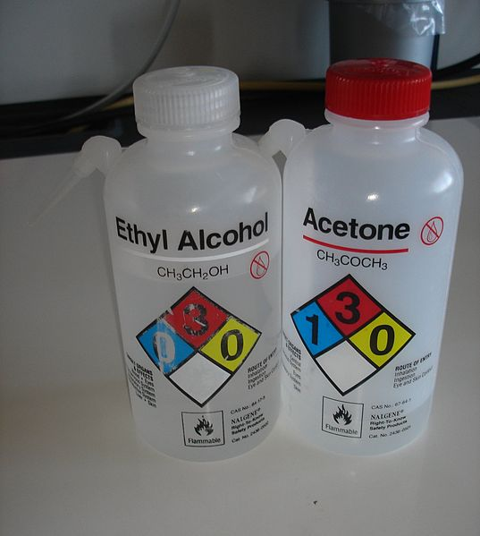
Fire safety and utility control
HAZ-MAT PLACARDS

Slide 34
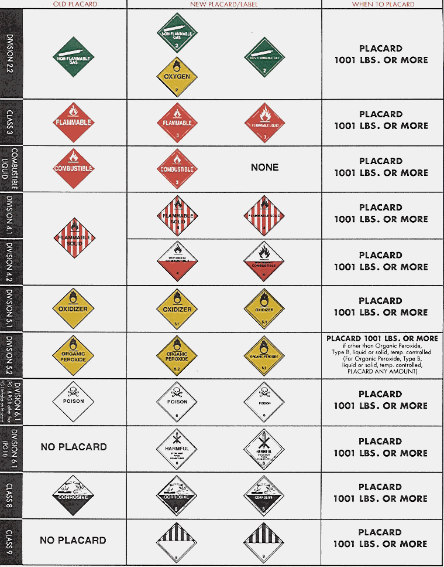
Fire safety and utility control
HAZARD PLACARDS
Material of Trade Exception 440lbs.

Slide 35
Fire safety and utility control
HAZARDOUS MATERIALS
ALWAYS READ YOUR LABELS
KEEP MSDS’s OR SAFETY LABEL INFORMATION
REMEMBER L.I.E.S. WHEN STORING CHEMICALS
LIMIT
ISOLATE
ELIMINATE
SEPARATE

Slide 36
Fire safety and utility control
HAZARDOUS MATERIALS
ITEMS THAT CAN CORRODE OTHER MATERIALS
ITEMS THAT COMBUST, EASILY IGNITE, OR EXPLODE
REACT STRONGLY WHEN MIXED IN WATER
BECOME UNSTABLE WHEN EXPOSED TO HEAT
ITEMS TOXIC TO HUMANS, ANIMALS, OR ENVIROMENT
VIA INHALATION
INJECTION
ABSORPTION
INGESTION

Slide 37
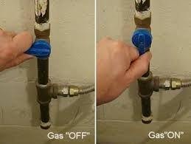
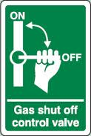
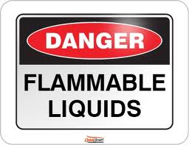
Fire safety and utility control
GENERAL SAFETY:
LABEL YOUR SHUT OFF VALVES
PLACE SIGNS THAT WARN OF HAZARDS OR EXPECTED BEHAVIORS.

Slide 38
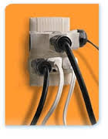
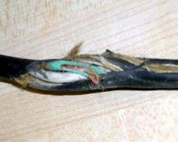
Fire safety and utility control
GENERAL SAFETY:
AVOID THE ELECTRICAL OCTOPUS
KNOW YOUR ELECTRICAL SYSTEM
WHERE ARE THE VEHCILE BREAKERS
GENERATOR SHUT OFF / BREAKERS
CHECK FOR WORN, BROKEN, FRAYED CORDS

Slide 39
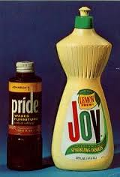
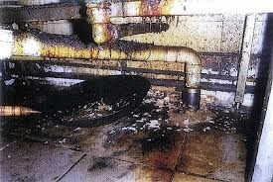
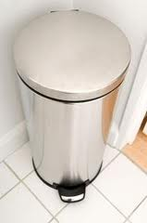
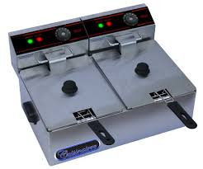
Fire safety and utility control
GENERAL SAFETY:
KEEP AREAS CLEAN AND SAFE
COVER DEEP FRYERS DURING TRANSIT
WATCH FOR SPILLED CLEANERS UNDER COUNTERS
WATCH TRASH STORAGE NEAR HEAT SOURCES
KEEP HOODS AND VENT SYSTEMS FREE OF GREASE BUILD UP.

Slide 40
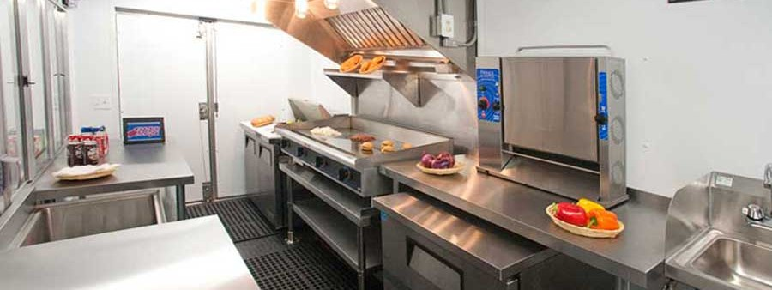
Fire safety and utility control
GENERAL SAFETY:
KEEP AREAS CLEAN AND SAFE
DO NOT USE GASOLINE AS A SOLVENT
DO NOT USE GASOLINE AS A CLEANER
DO NOT REFILL A GASOLINE OPERATED DEVICE UNTIL IT COOLS DOWN.
WATCH WHERE YOUR STORING YOUR FLAMMABLE, COMBUSTIBLE, AND CHEMICALS.

Slide 41
Fire safety and utility control
GENERAL SAFETY:
KEEP VALVES CLOSED WHEN NOT IN USE.
YOU MAY NOT STORE GASOLINE INSIDE THE VEHICLE WHILE IN OPERATION.
YOU SHOULD NOT LEAVE THE GASOLINE CONTAINER IN SUNLIGHT.
IF YOU SPILL ANY GASOLINE ON YOU, YOU MUST WASH AND OR CHANGE CLOTHING. VAPOR CAN IGNITE YOUR CLOTHING OR HANDS

Slide 42
Fire safety and utility control
REFERENCE SITES FOR YOU TO REVIEW
NATIONAL FIRE PROTECTION AGENCY
http://www.nfpa.org/itemDetail.asp?categoryID=279&itemID=18123&URL=Codes%20&%20Standards/Standards%20development%20process/Online%20access
US DEPARTMENT OF TRANSPORTATION – 49CFR 178
http://www.ecfr.gov/cgi-bin/text-idx?c=ecfr&tpl=/ecfrbrowse/Title49/49cfr178_main_02.tpl

Slide 43
Fire safety and utility control
FOR MORE INFORMATION:
Fire Safety Inspector Steve Ersteniuk
(585) 428-5954
Stephen.Ersteniuk@CityofRochester.gov
Lieutenant Edward Kuppinger
(585)428-5956
Edward.Kuppinger@CityofRochester.gov

