Slide 1
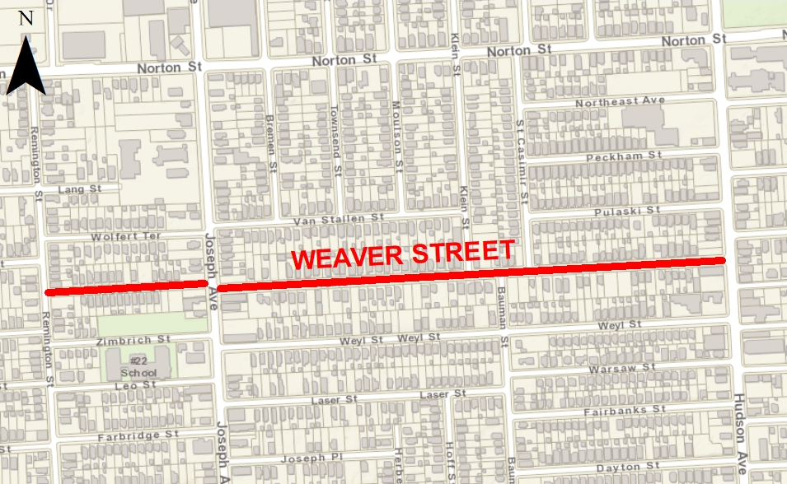
Weaver Street Rehabilitation Project
Weaver Street (Remington Street to Hudson Avenue)
Public Information Meeting
Wednesday September 15, 2021
at 5:30 p.m.
Via Zoom Video Webinar
City of Rochester
Department of Environmental Services
Bureau of Architecture & Engineering
Street Design Division
City Hall, 30 Church Street, Room 300B, Rochester, NY 14614

Slide 2
Format of Zoom Webinar
Attendance: Please use the “chat” feature to provide your name and address.
Questions: Meeting participants will be muted during the presentation. Questions will be addressed at the end of the presentation.
Consent: Attendees consent to the audio recording of this meeting for the purpose of project documentation.

Slide 3
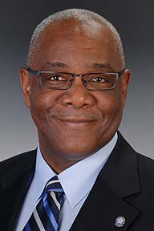
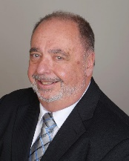
Project Team
Mayor Lovely A. Warren
Department of Environmental Services
Commissioner Norman H. Jones
City Engineer Holly E. Barrett, P.E.
Director, Water Bureau Geoff Gugel, P.E.
Managing Engineer, Street Design Dominic Fekete, P.E.
Project Team
City Project Manager, Street Design Phoenix Howell – Host
Lu Engineers (Design Consultant) Jonathan Ottman, P.E. – Co-Host
Monroe County Dept. of Transportation Henry Herdzik, P.E.
City Zoning, Christopher Snyder
City Permits, John Hart

Slide 4
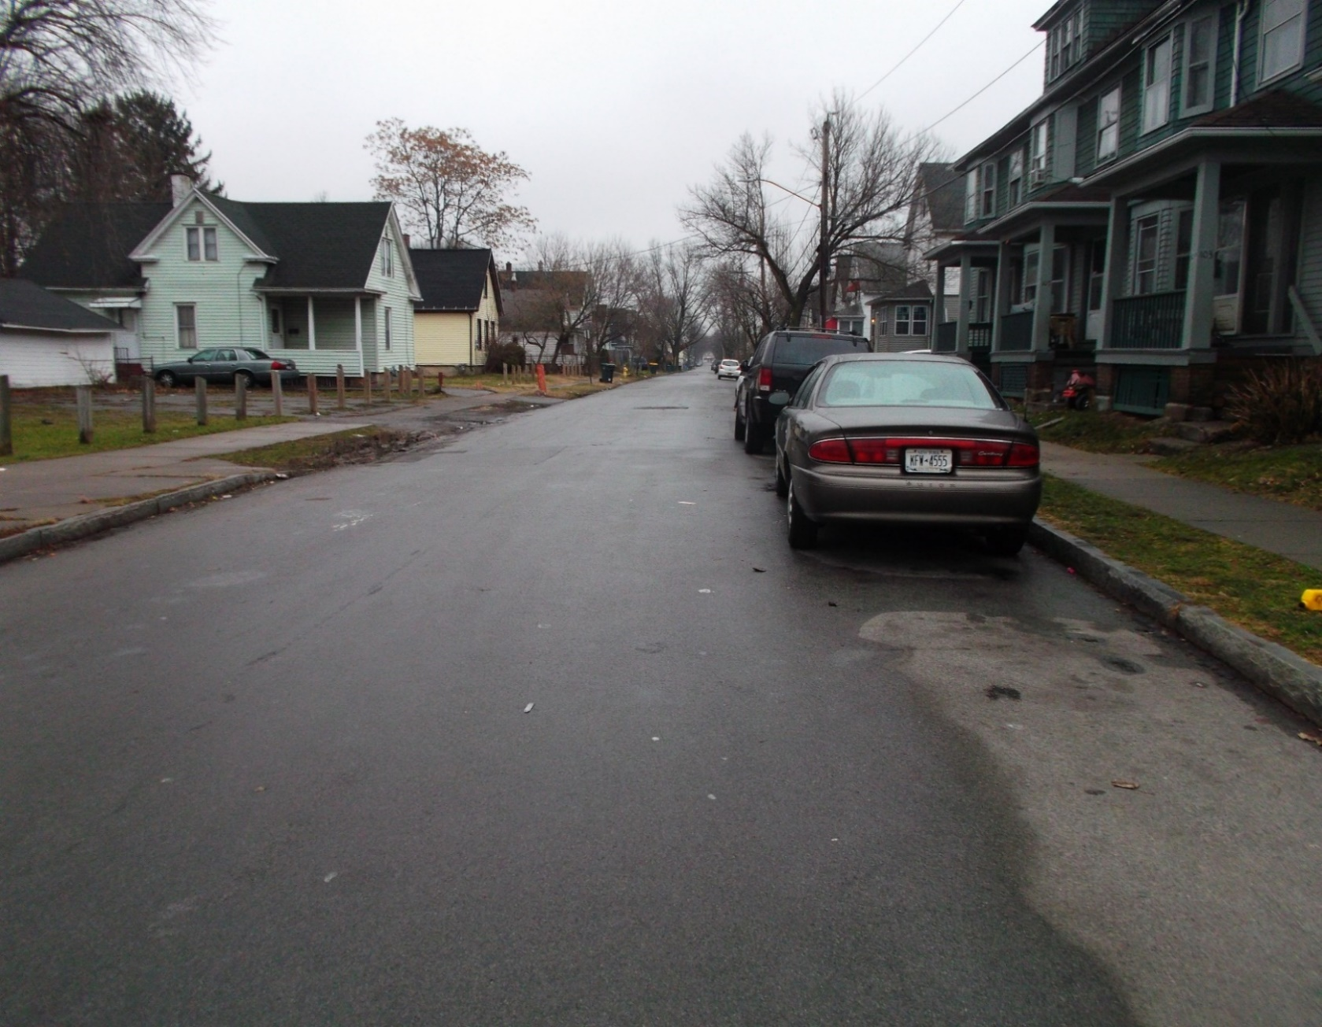
Public Meeting Agenda
Weaver St looking eastward from Joseph Avenue
Project Limits
Street Improvements
Roadway, Curbs, Driveways, Speed Humps
Pedestrian & Traffic Safety Improvements
Sidewalks, Carriage Walks, Sidewalk Curb Ramps, Crosswalks & Signage
Street Lighting Improvements
Street Trees
Construction Work Zone Traffic Control
Utility Improvements
Anticipated Project Timeline
Additional Information
Questions or Comments

Slide 5
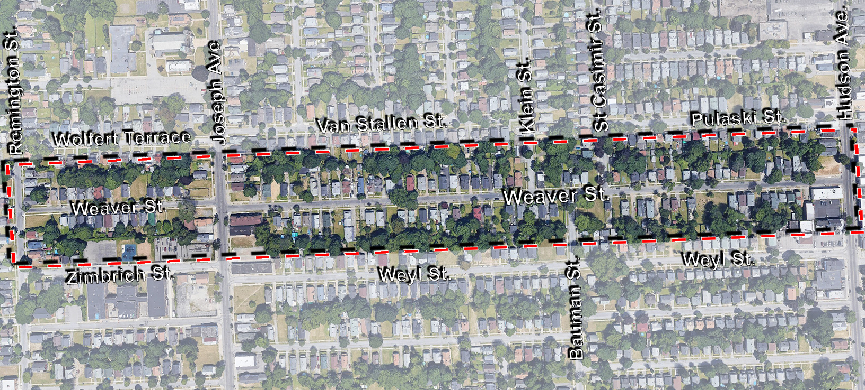
Project Limits Weaver Street (Remington Street to Hudson Avenue)
Driving Park Avenue
Weaver St, Google Maps, 2021, maps.google.com
Not to Scale

Slide 6
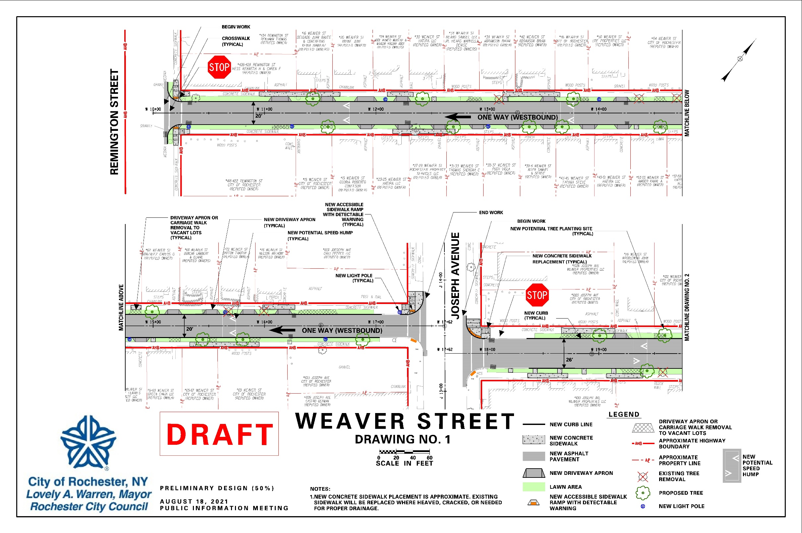
Refer to https://www.cityofrochester.gov/weaver/ for a PDF of the display

Slide 7
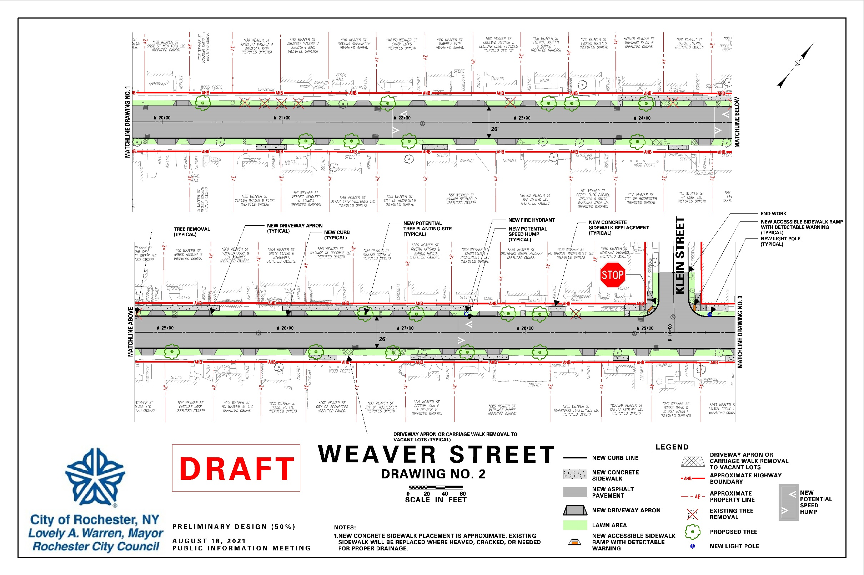
Refer to https://www.cityofrochester.gov/weaver/ for a PDF of the display

Slide 8
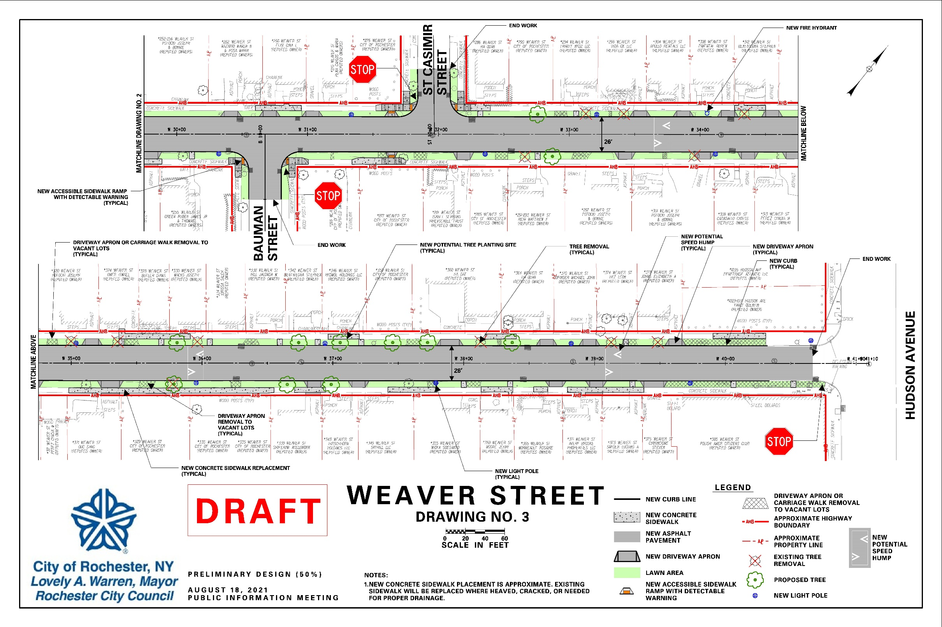
Refer to https://www.cityofrochester.gov/weaver/ for a PDF of the display

Slide 9
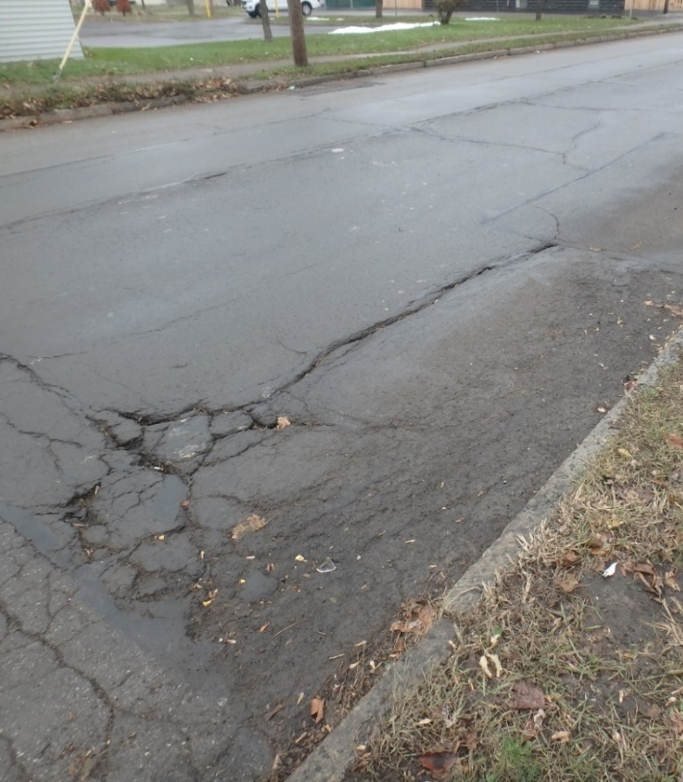
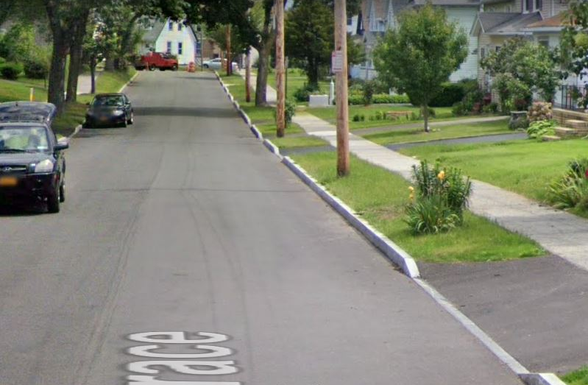
Street Improvements Roadway Pavement Structure
For this project the design may dictate the need to partially or fully reconstruct the street, if budget allows.
Why Pavement Rehabilitation?
It is a cost effective treatment compared to full reconstruction
It combines curb replacement with milling and resurfacing (M&R) of the pavement
Extends the life of the road
Improves drainage
Improves pavement ride quality
Before
After

Slide 10
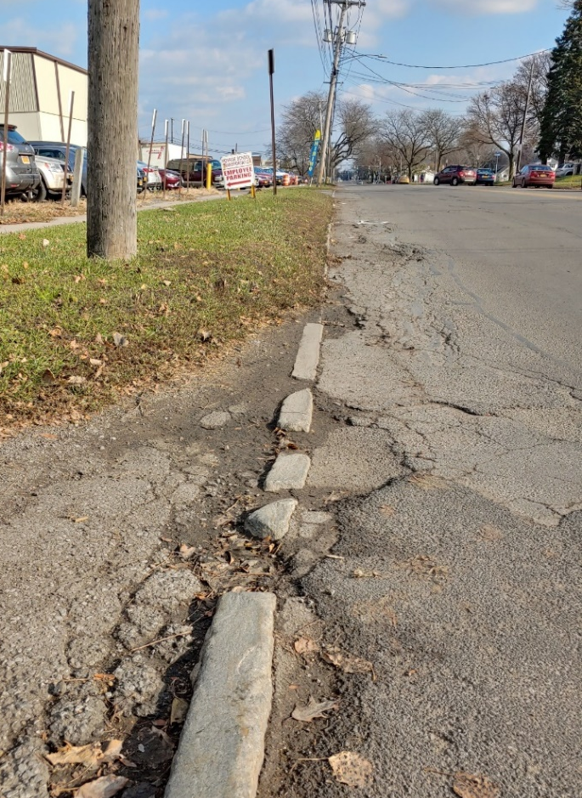
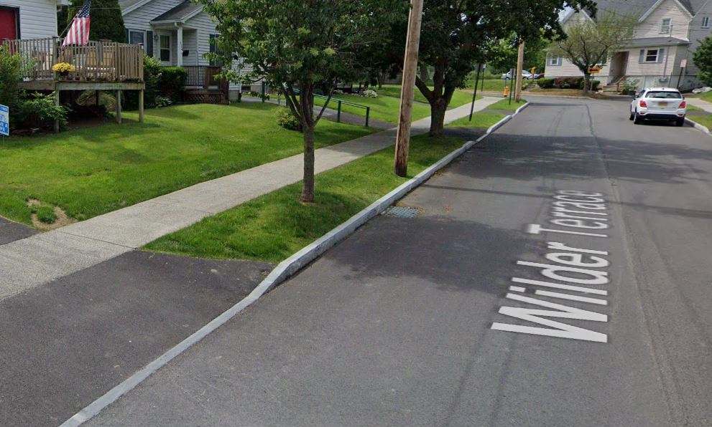
Street Improvements Granite Stone Curbs
Before
All existing curbing will be replaced throughout the project limits, including through all the driveway aprons and at some accessible curb ramps
After

Slide 11
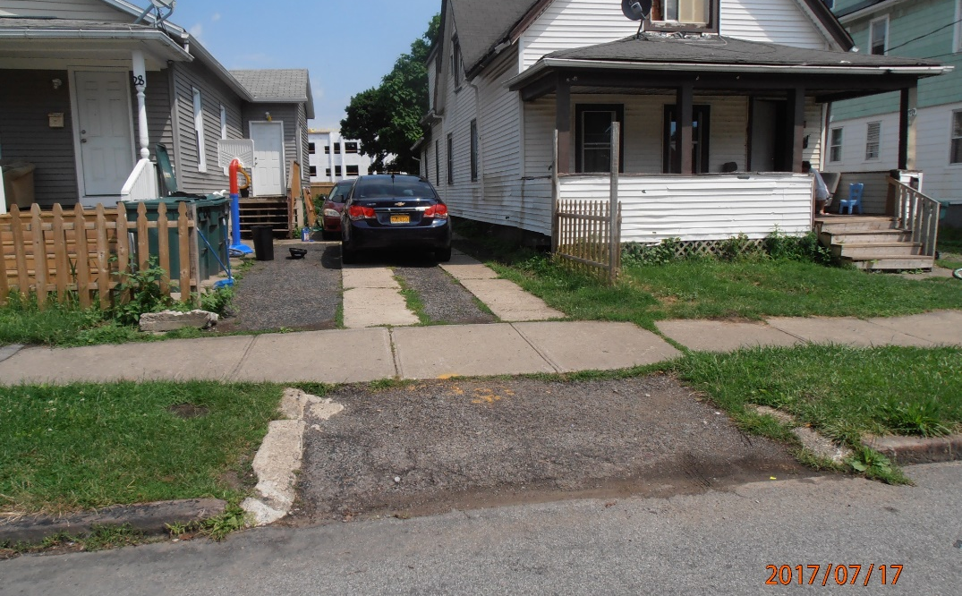
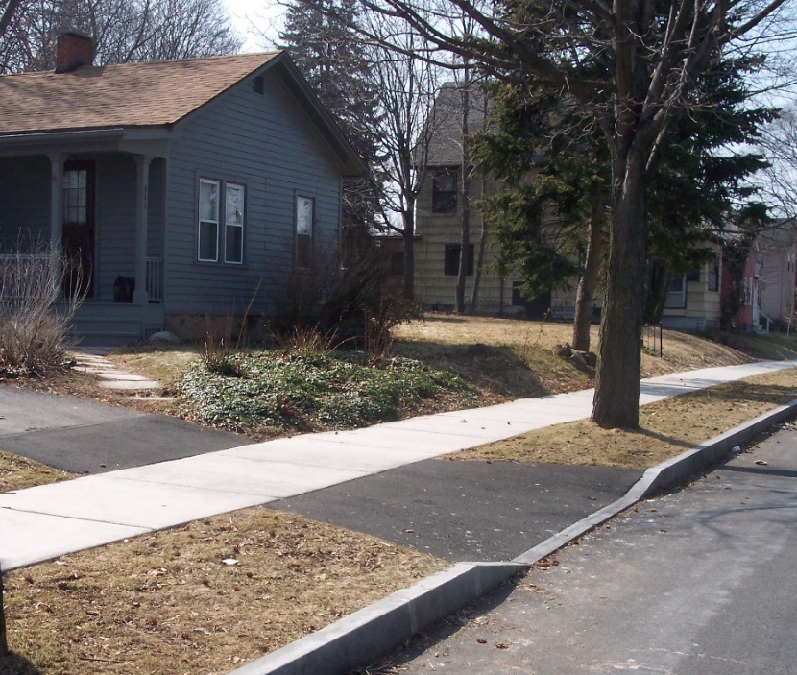
Street Improvements Driveway Curb Cuts (Aprons)
Driveway curb cuts to all vacant parcels will be closed off with full height granite stone curb and lawn restoration.
Driveway curb cuts are reviewed by the City Permits and Zoning for the project
Property owners must contact City Zoning to legalize their driveway curb cut when it has been removed as part of the project or a new location is desired. The request will be granted if feasible within the zoning code requirements
Driveway openings are designed and constructed per City standards
Before
Before
After

Slide 12
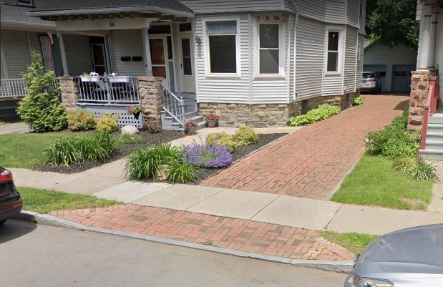
Street Improvements Driveway Material Policy
2020 Google
DRIVEWAY MATERIALS
Existing Surface | New Surface
Asphalt | Asphalt
Gravel | Asphalt
Concrete | Concrete
Brick (good condition) | Brick over concrete base
Brick (failing) | Concrete
If prior to construction the property owner desires to pay the difference in cost to “upgrade” from an asphalt apron to a concrete apron, the owner must inform the City Project Manager to determine the next steps and cost to upgrade.

Slide 13
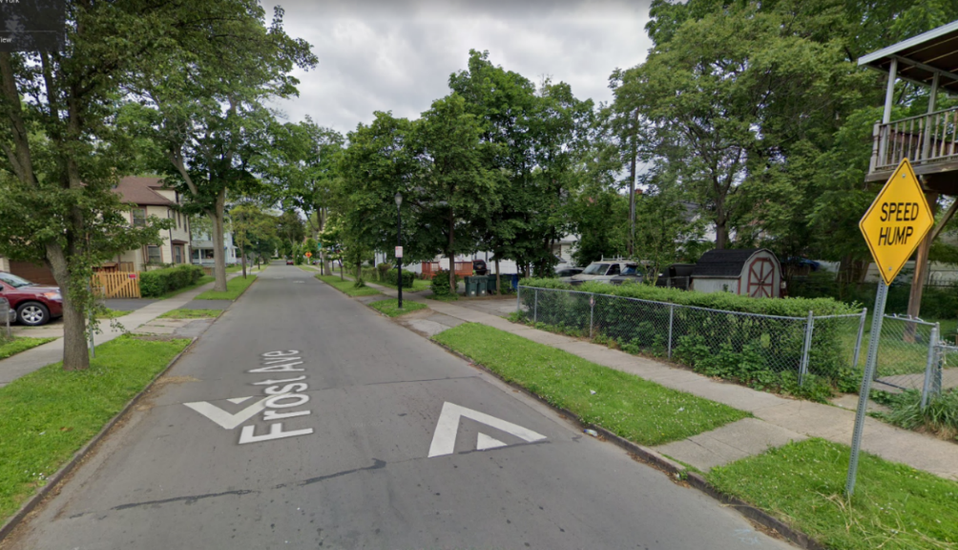
Pedestrian and Traffic Safety Improvements Speed Humps
DRAFT LAYOUT
The City received requests from residents to install speed humps
Speed Hump Example
Klein St
St Casimir St
Weaver St
Joseph Avenue
Weaver St
Hudson Avenue
Bauman St
Weyl St
Weyl St

Slide 14
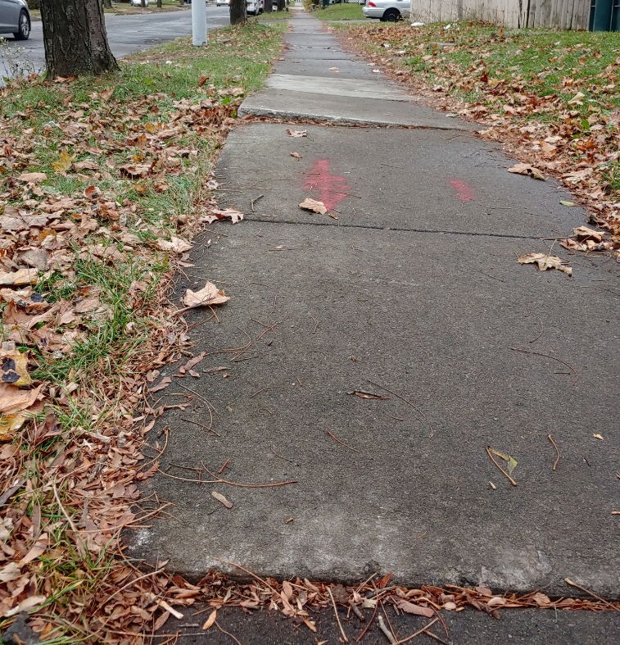
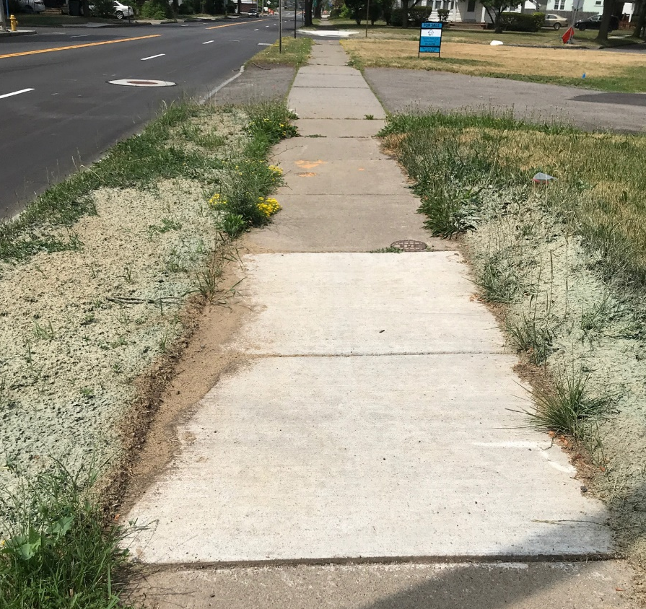
Pedestrian and Traffic Safety Improvements Public Sidewalks
Before
After
Sidewalks will be replaced where heaved, cracked, or as needed to provide proper drainage
Sidewalks attached to the curb will also require replacement
Notes:
City’s Hazardous Sidewalk Repair Program states: replace sidewalks when a difference in elevation at the crack or joint is at least one and half (1.5”) inches, or if they are severely deteriorated.

Slide 15
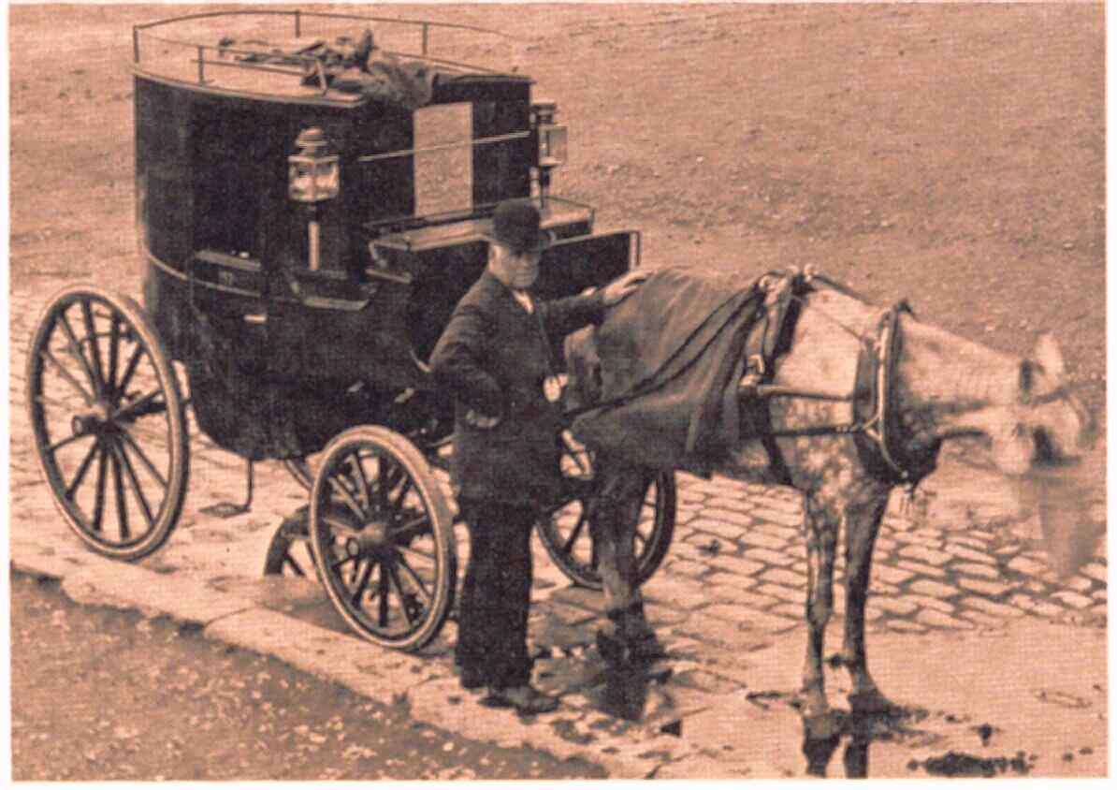
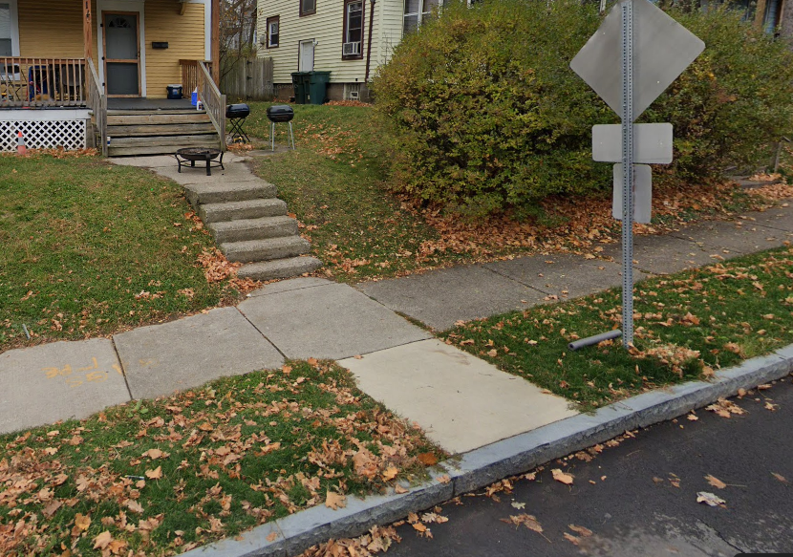
Pedestrian and Traffic Safety Improvements Carriage Walk
Original purpose: easing the process of entering and exiting a horse-drawn carriage
A Carriage Walk is a concrete sidewalk from the curb to the public sidewalk
CARRIAGE WALK INSTALLATION
No existing Driveway | Carriage walk Installed
Existing Driveway | Carriage walk Removed
Request a new carriage walk | Owner pays for installation
Carriage Walk
Notes:
City’s Hazardous Sidewalk Repair Program states: replace sidewalks when a difference in elevation at the crack or joint is at least one and half (1.5”) inches, or if they are severely deteriorated.

Slide 16
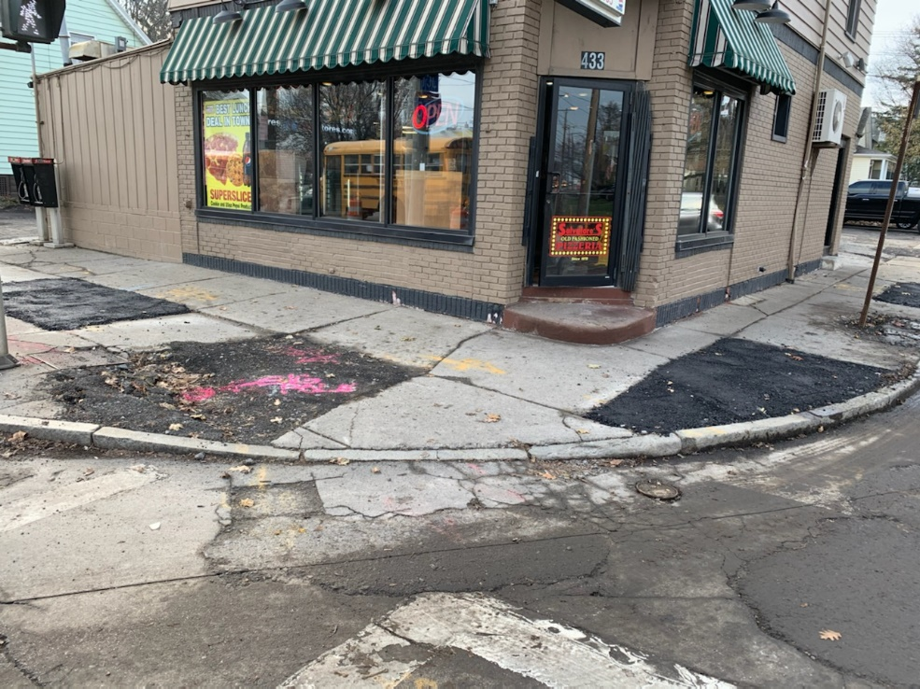
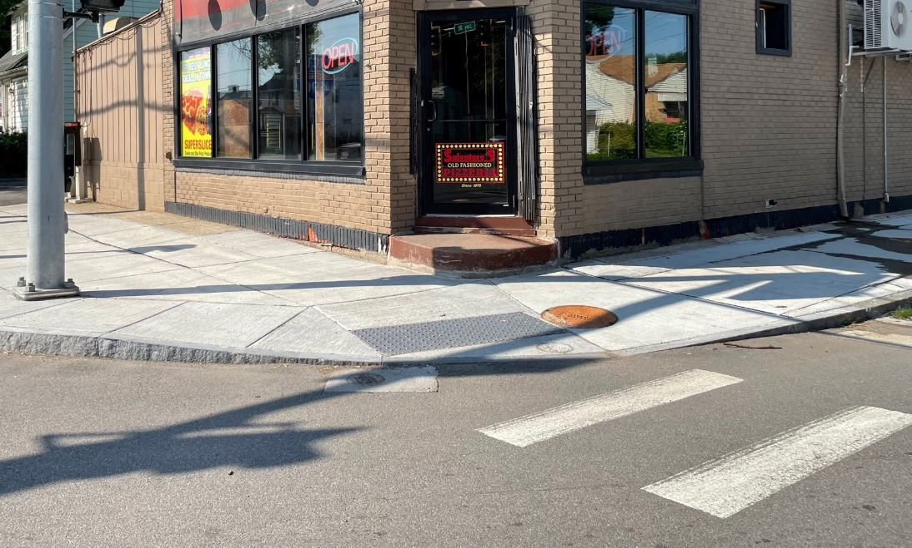
Pedestrian and Traffic Safety Improvements Sidewalk Curb Ramps
Sidewalk curb ramps will be retrofitted, modified, or replaced where needed. Detectable warning surfaces will be installed as needed to address accessibility requirements
Before
After

Slide 17
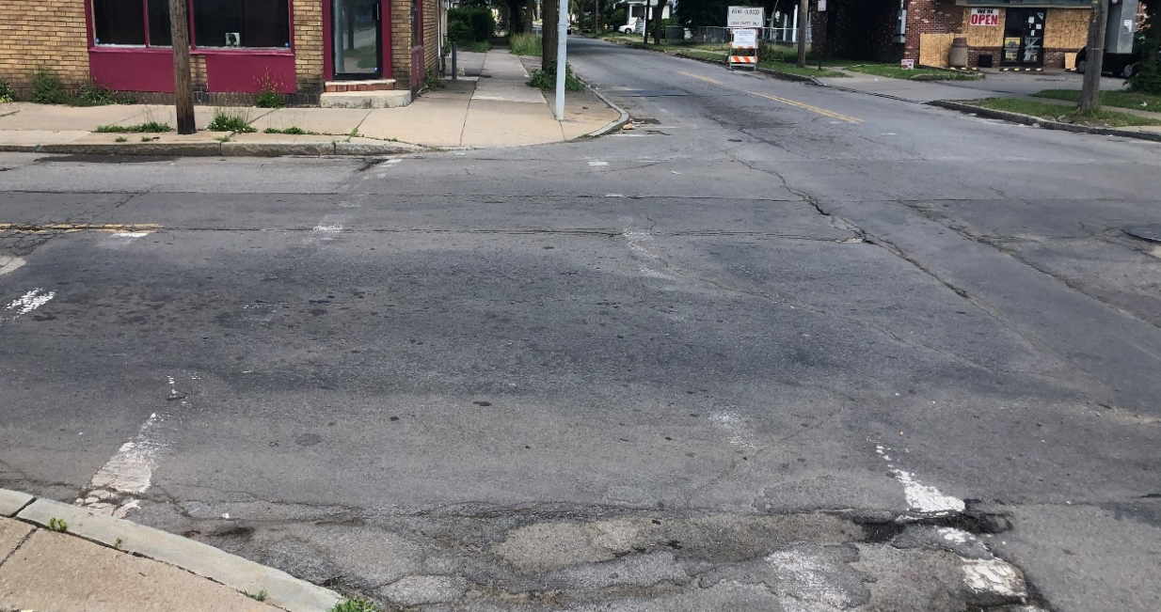
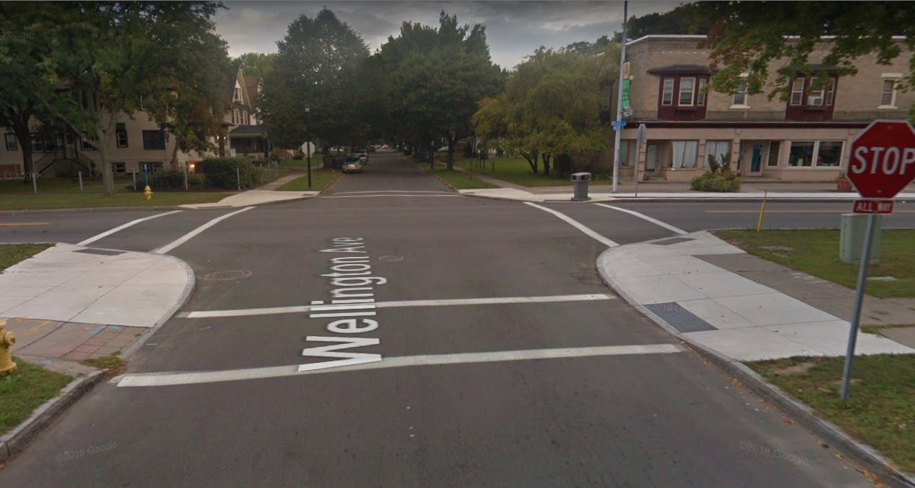
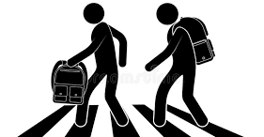
Pedestrian and Traffic Safety Improvements Crosswalks and Traffic Signage
Before
High visibility crosswalks at Weaver Street intersections will be replaced
Regulatory traffic signs throughout the project limits will be replaced, as needed
After

Slide 18
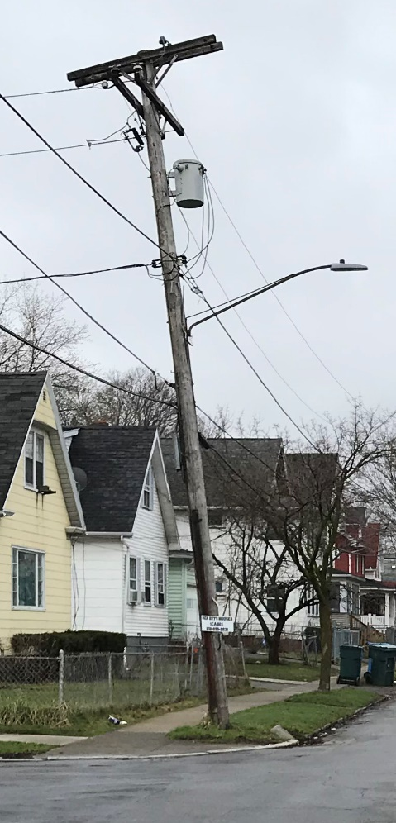
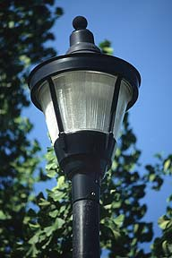
Street Lighting Improvements Improved safety for pedestrians and vehicles
New post-top fiberglass light poles
Remington St to Joseph Ave
Davit arms and LED fixtures will be added to new and existing wood poles
Joseph Ave to Hudson Ave
Wood Pole
Joseph Ave to Hudson Ave
Street Light Pole
Remington St to Joseph Ave

Slide 19
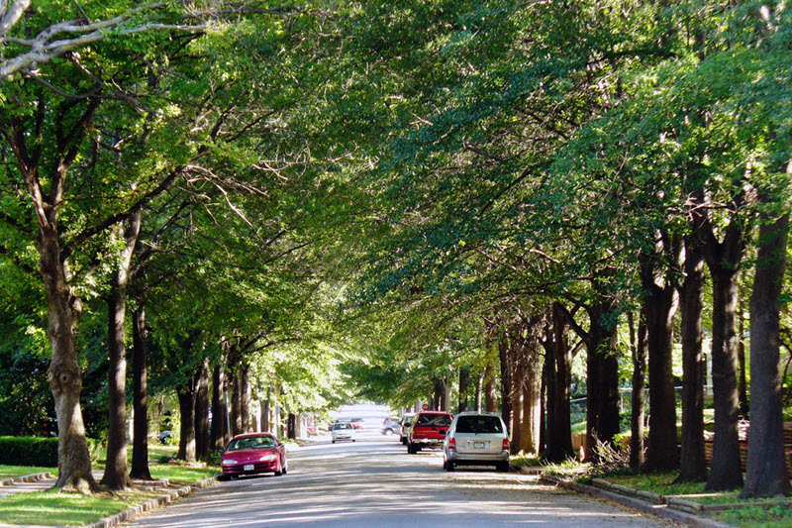
Street Trees Planting in the public Right-of-Way
Contact the Project Manager if you do not want a tree planted in front of your home or to request a tree planting in the public right-of-way
City Tree Planting
After most of the improvements have been made a new street tree may be planted in front of your home within the City’s public Right-of-Way
City Forestry Division will be responsible for the care and maintenance of the new street trees

Slide 20
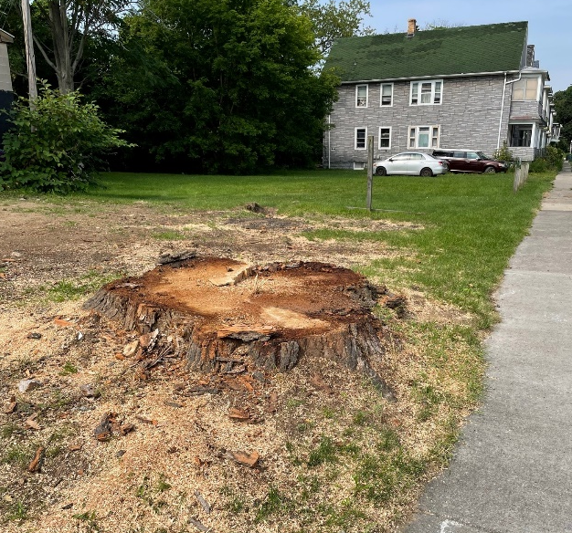
Street Trees Removals in the public Right-of-Way
City Tree Removal
will only occur under the following circumstances:
Public Safety: When a hazard constitutes removal of more than 50 percent of the live crown or when the structural integrity of the tree is undermined to the point that it is susceptible to wind fall
Urban Forest Health: When tree disease significantly threatens the health of other city trees
Fiscal Management: When tree maintenance practices exceed the value of the tree or maintenance will not prolong the tree's life beyond five years
Tree removal at 1013 Joseph Ave

Slide 21
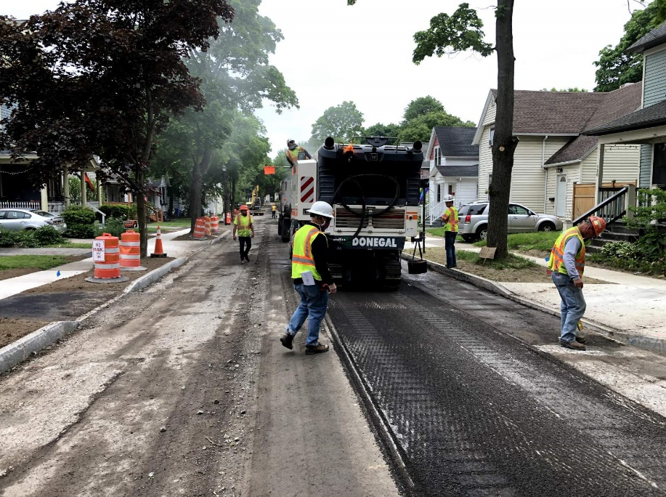
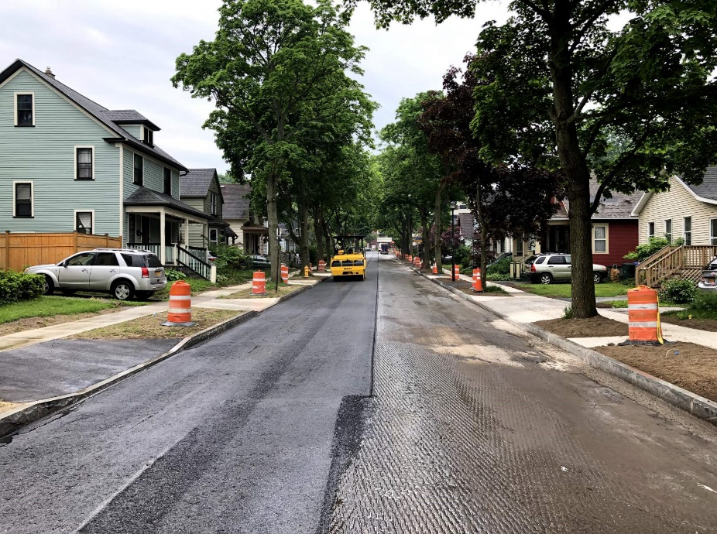
Construction Work Zone Traffic Control Timeframe and Access
Construction is anticipated to last approximately 5 - 6 months
Two-way traffic will be maintained with flaggers and daily lane closures when needed
Some temporary disruptions will occur during curb and sidewalk replacement at driveways (estimated 3 - 5 days)
Emergency access will be maintained during construction
Milling
Resurfacing
Resurfacing
**If there are known medical emergency access needs at any of the properties within the project limits, please inform the City’s Construction Project Manager so that the appropriate measures are taken to maintain access during construction at all times.**

Slide 22
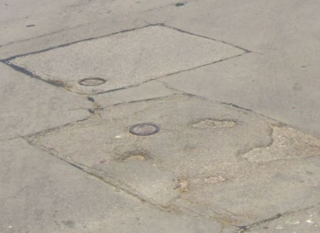
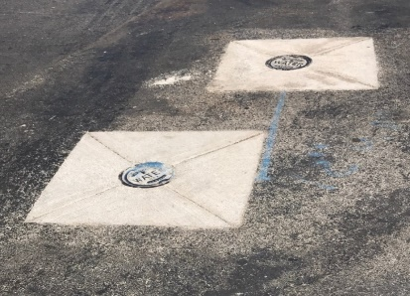
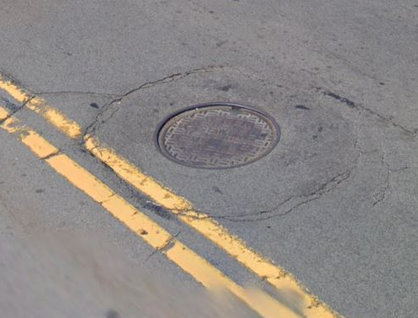
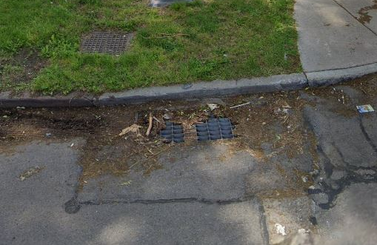
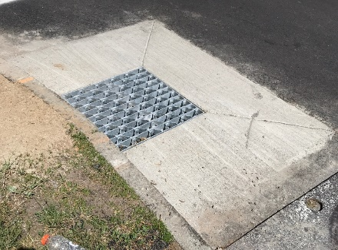
Utility Improvements
Work to be completed ahead of Street Construction
BEFORE
AFTER
Water Valves
City Water Bureau
Cleaning and cement mortar lining of water main (complete)
Replacement of lead water services (on-going)
Small section of water main replacement (on-going)
Hydrant relocations (during street construction)
Manhole
Drainage Inlet
Rochester Gas & Electric
Gas: New gas main to be installed along the northern sidewalk
Electric: Some wood poles will be replaced and relocated
Utility Appurtenances
Adjust to grade with a concrete collar
Frontier
Replace existing wood ducts
Other Utilities
Relocate overhead wires
Emerson Street

Slide 23
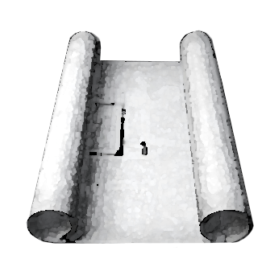
Anticipated Project Timeline
Fall 2021
Final Design Complete
Fall 2022
Construction Ends
Summer 2021
Preliminary Design Complete
Spring 2022
Construction Begins

Slide 24
Additional Information
Check the City of Rochester Project Webpage for updates on project schedule, meeting minutes, and public meeting displays
https://www.cityofrochester.gov/weaver/

Slide 25
Questions or Comments
Please provide your name and address when asking a question
To ask a question on the COMPUTER:
Click Raise Hand in the webinar controls
The Host will be notified that you have raised your hand
Click lower Hand when finished
Thank you for your time.
For additional information, please contact:
Phoenix Howell at 585.428.6284 or
Phoenix.Howell@CityofRochester.Gov
To ask a question on the PHONE:
Dial *9 to Raise your Hand
Dial *6 to Unmute
Keyboard Shortcuts:
Windows: You can also use Alt+Y keyboard shortcut to raise your hand
Mac: You can also use Option+Y keyboard shortcut to raise your hand

